Slide 1
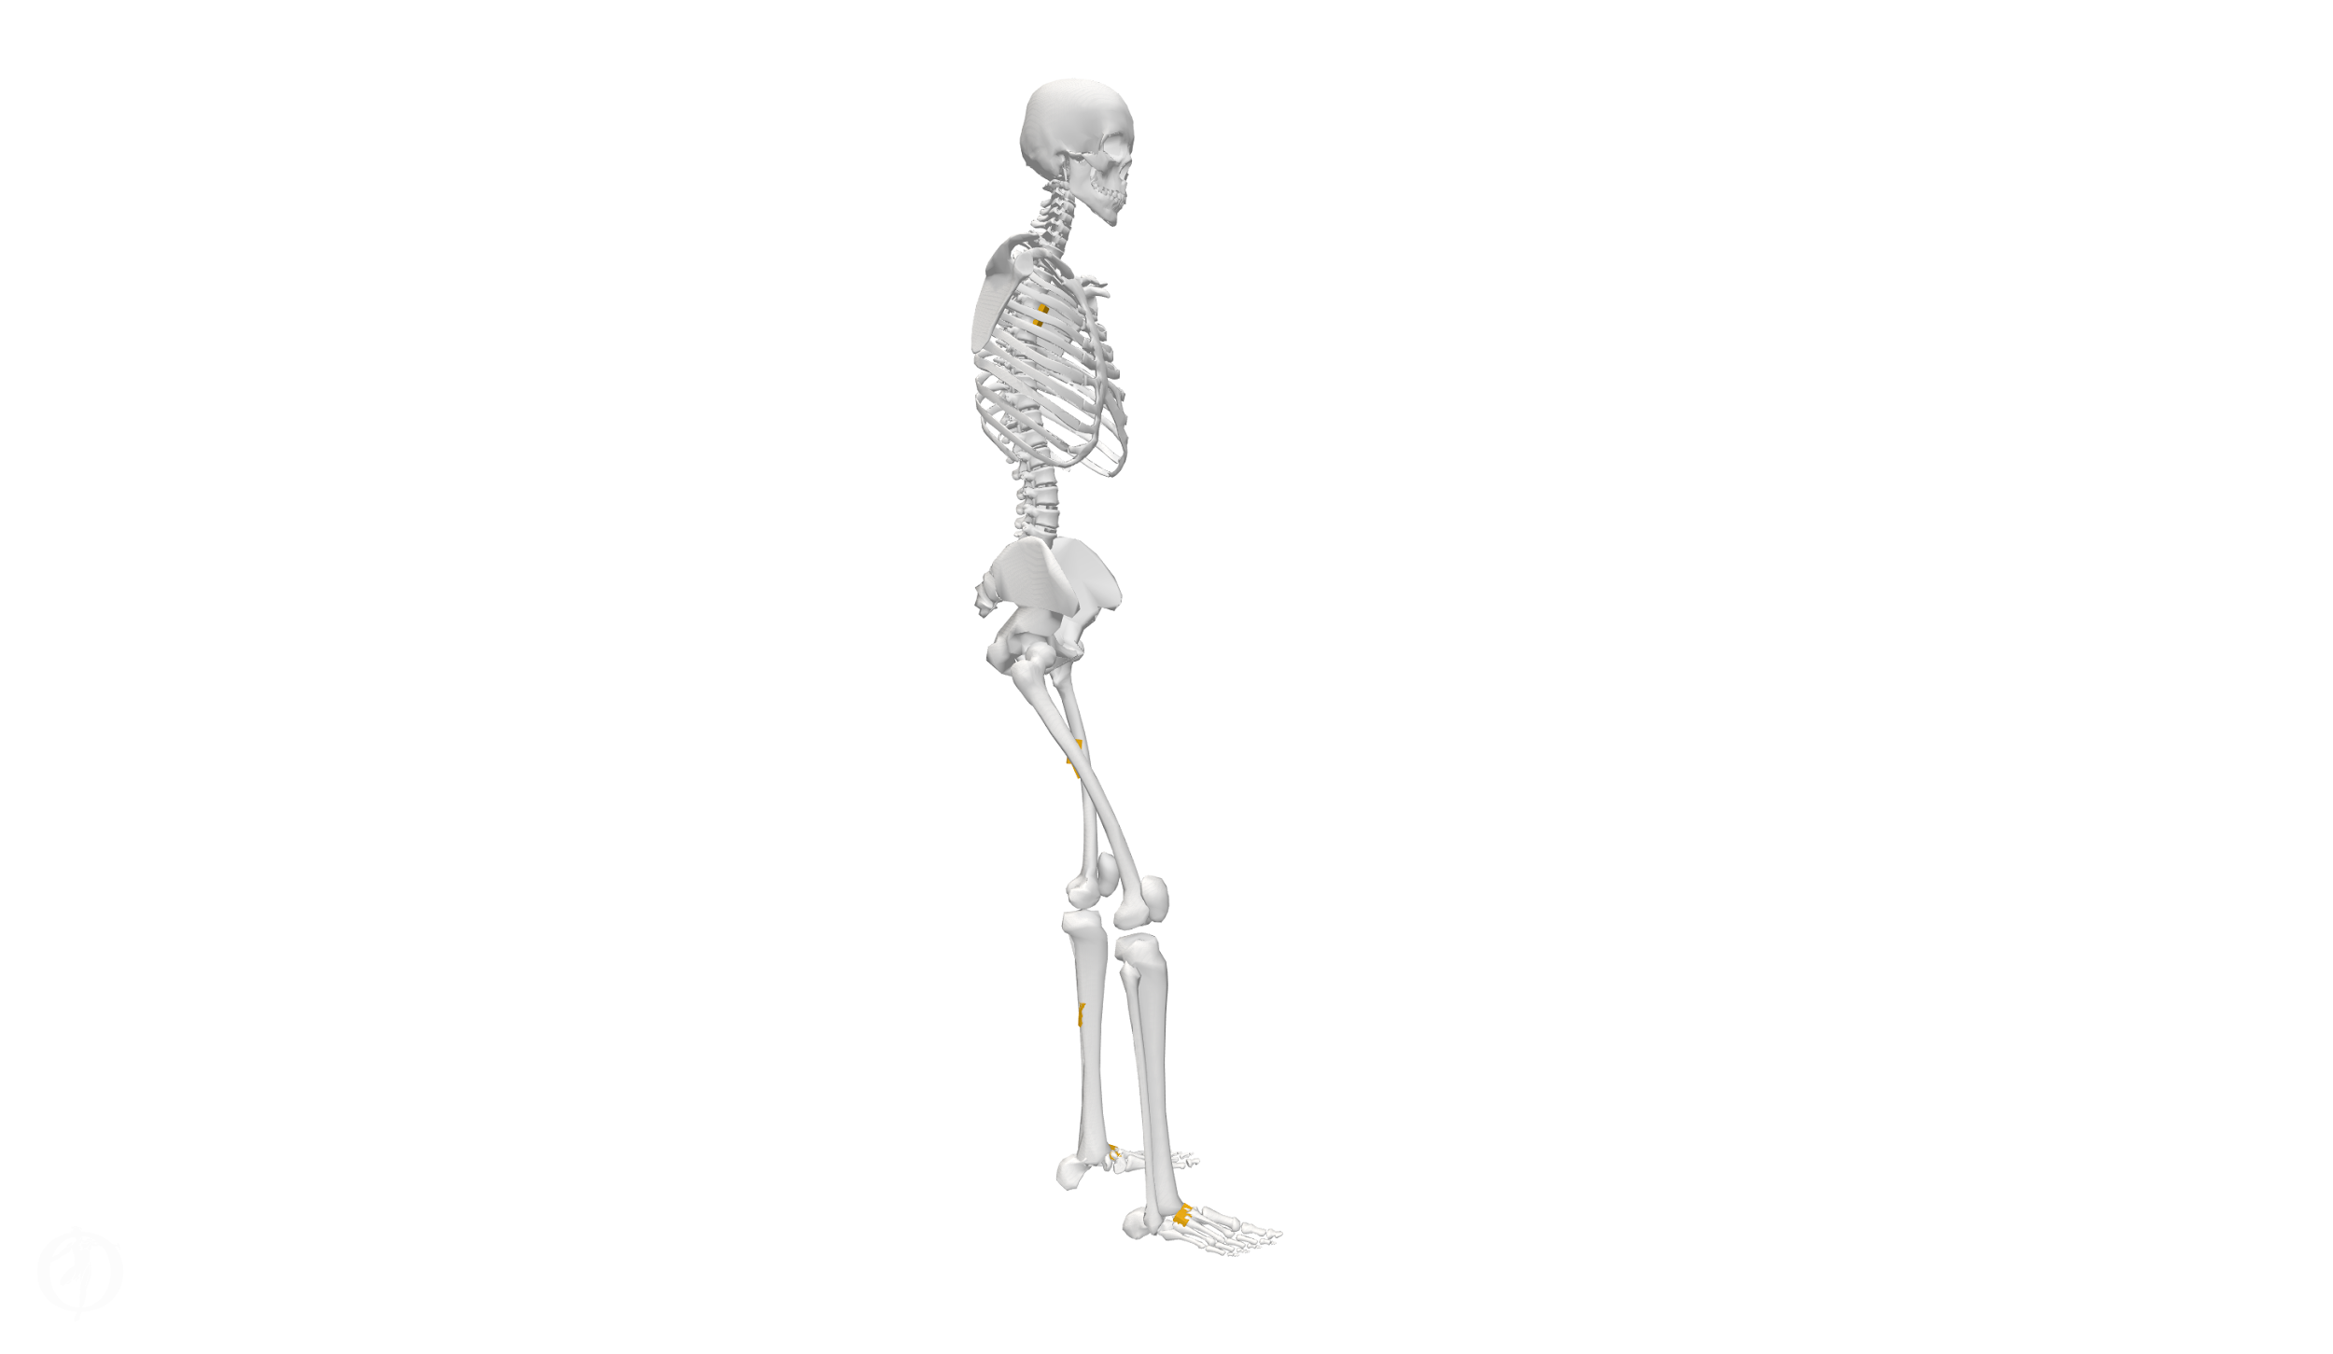
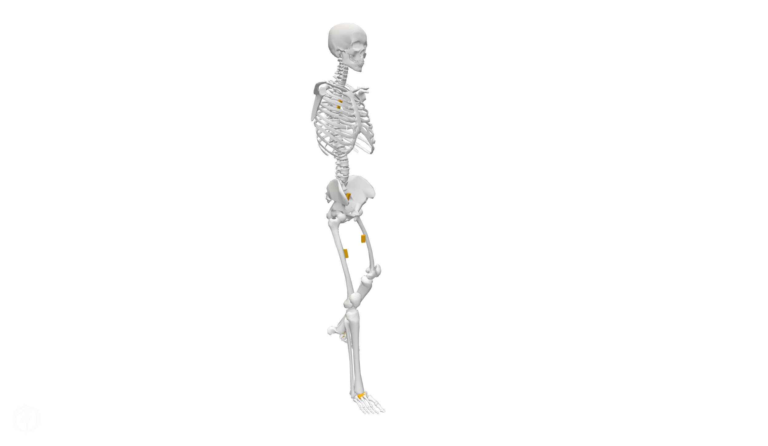
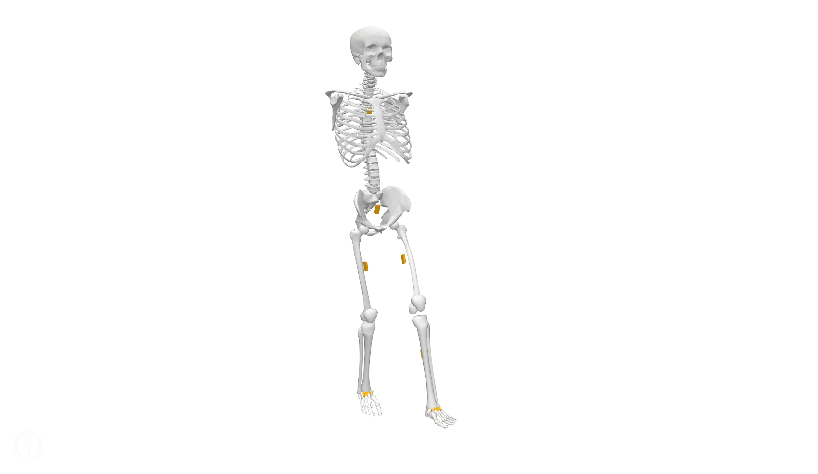
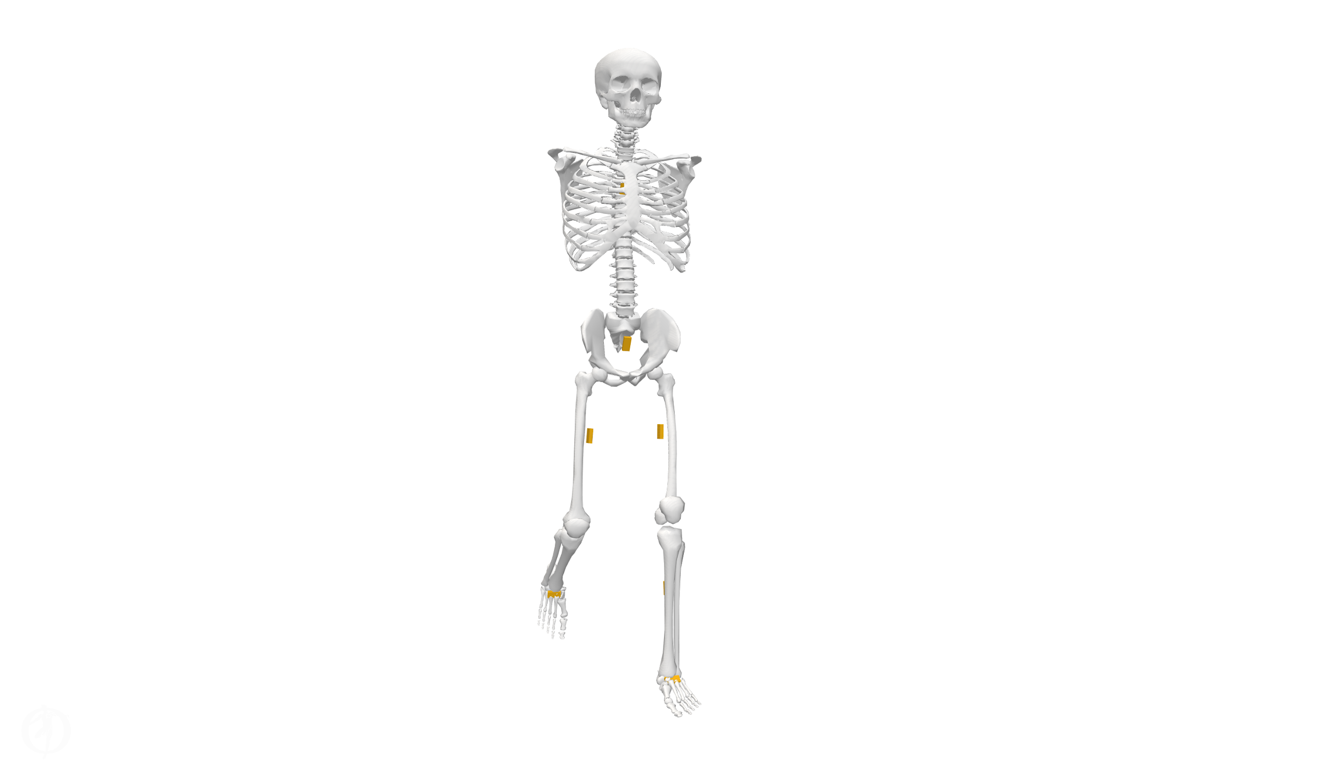
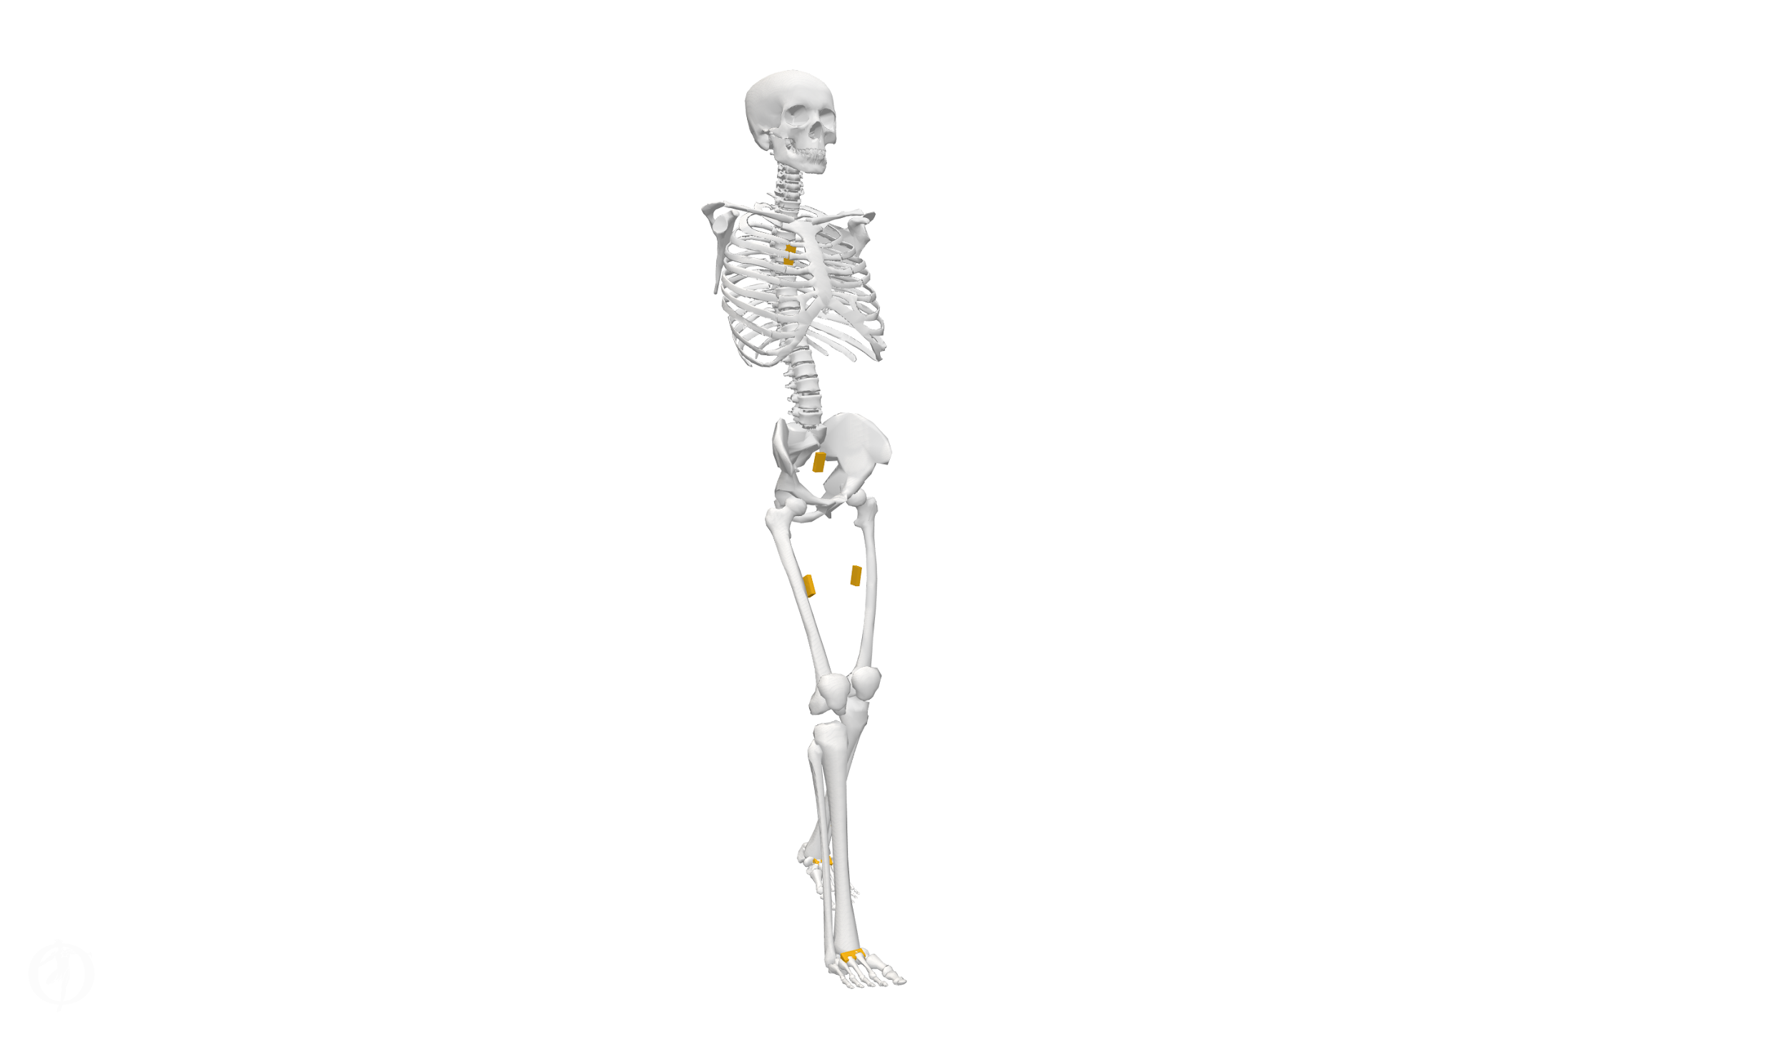
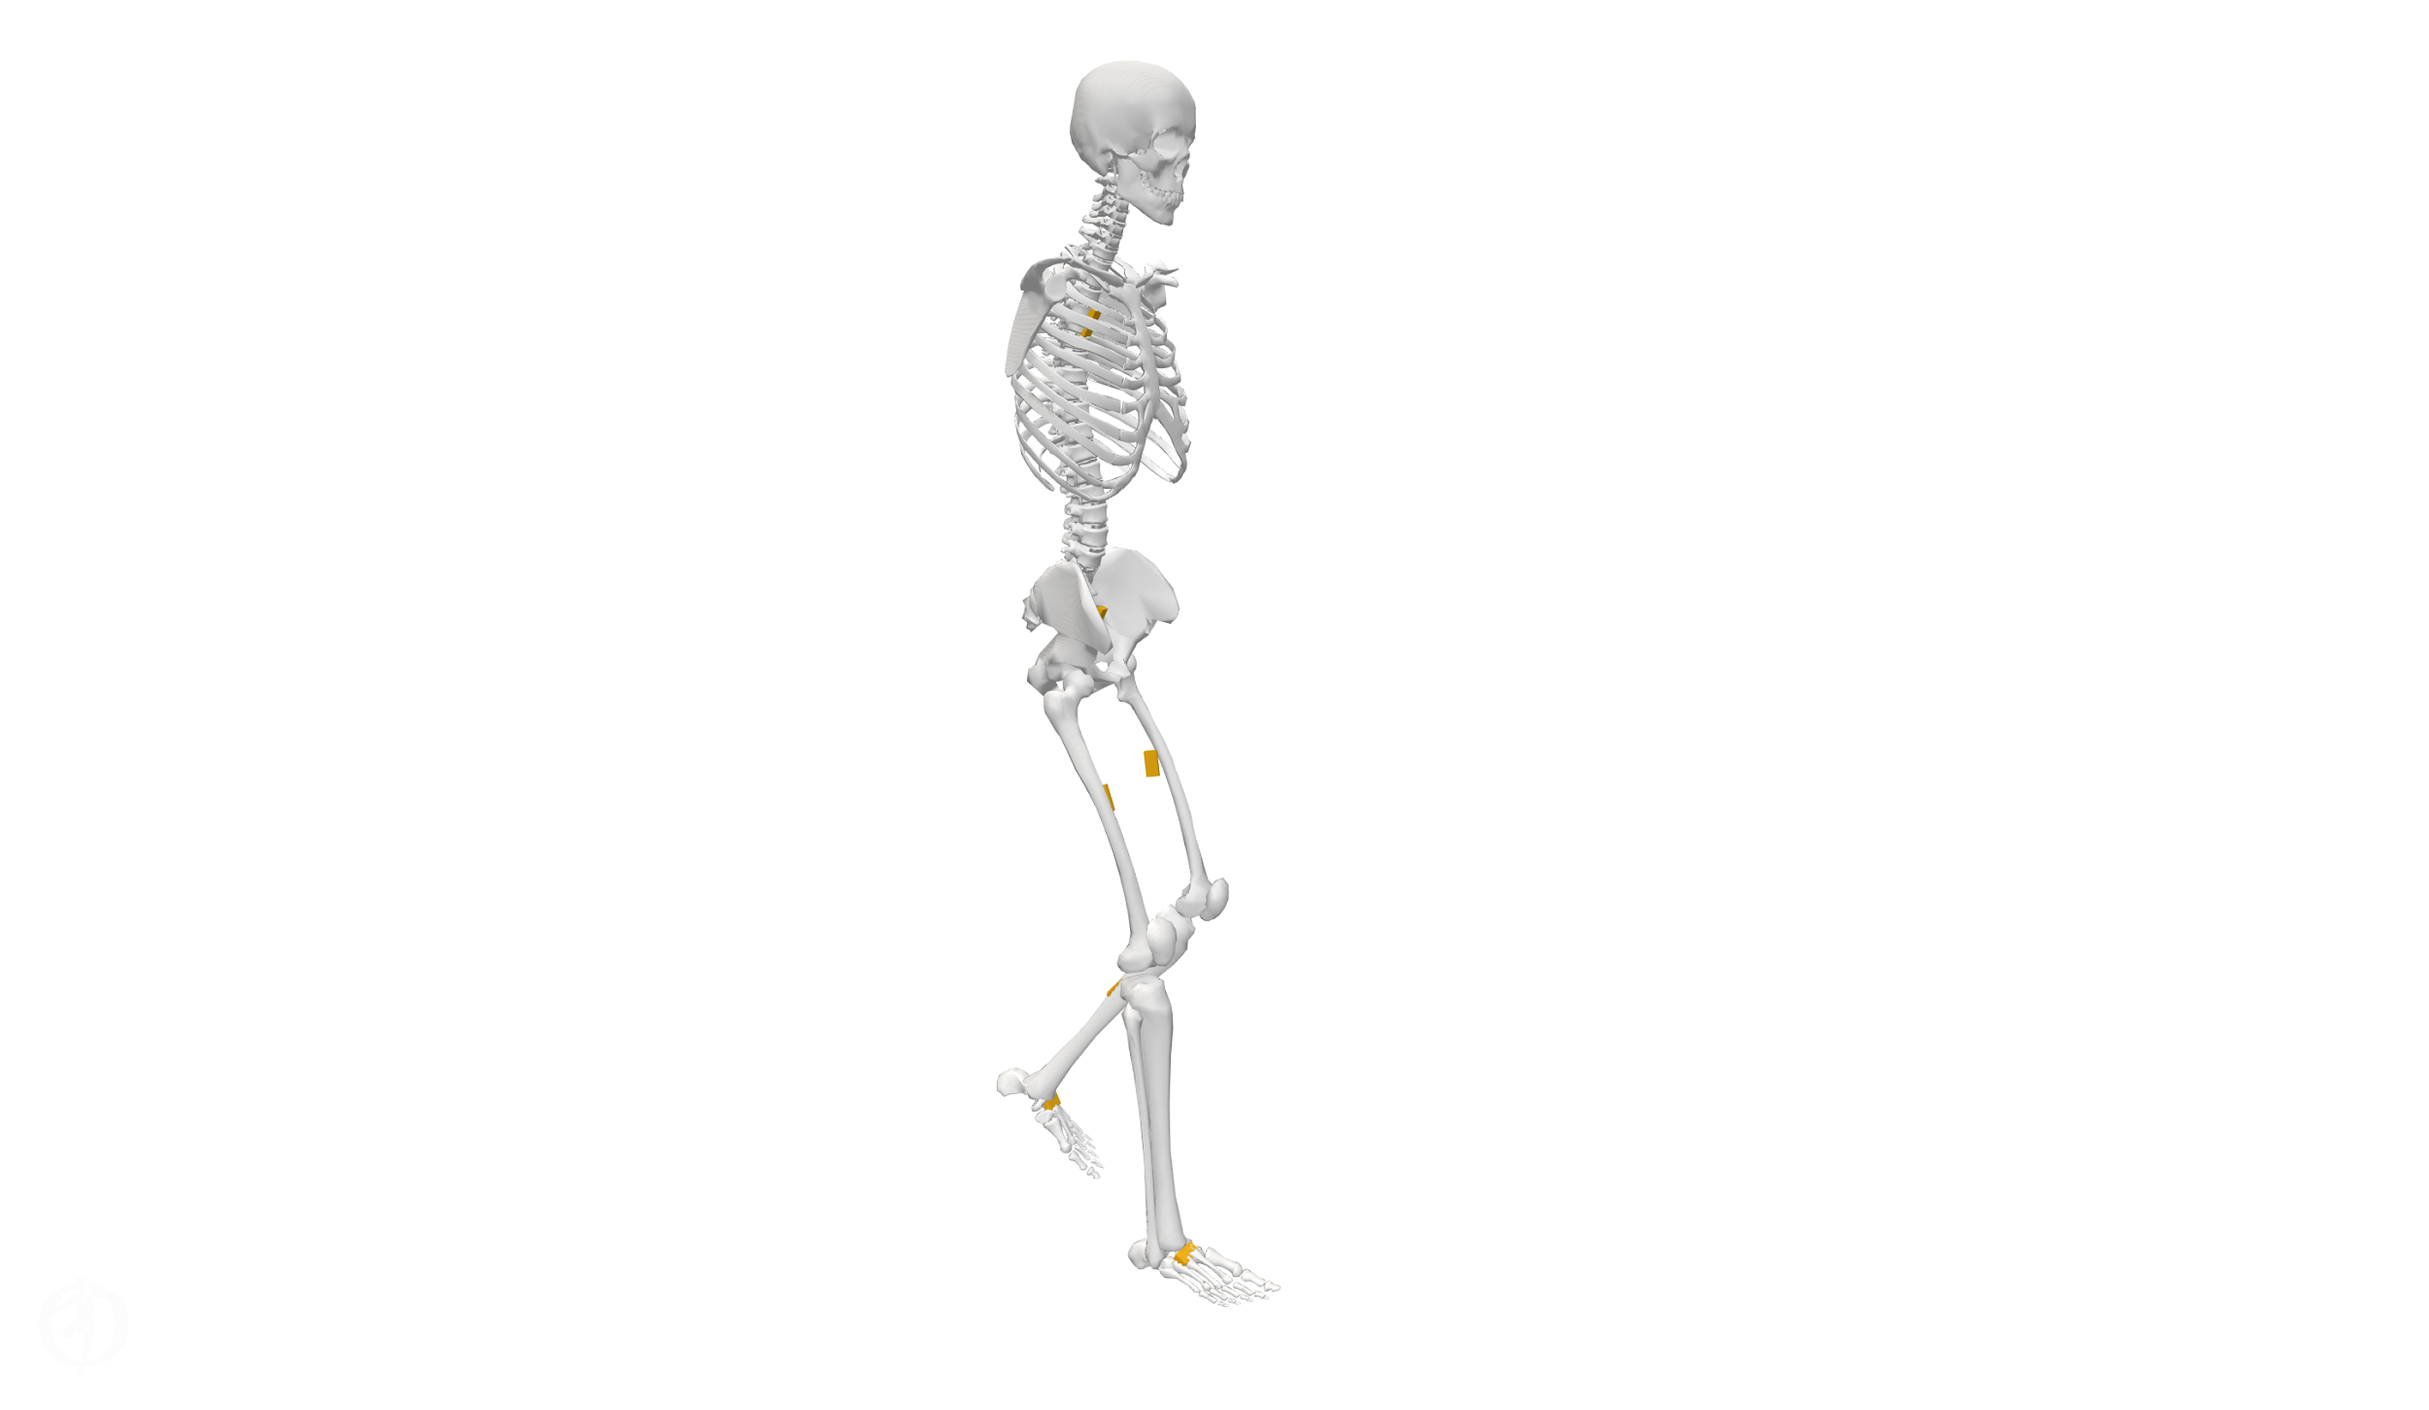
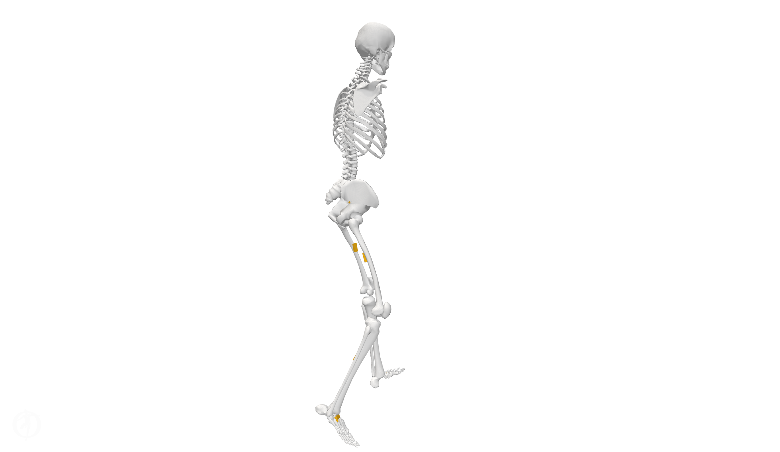
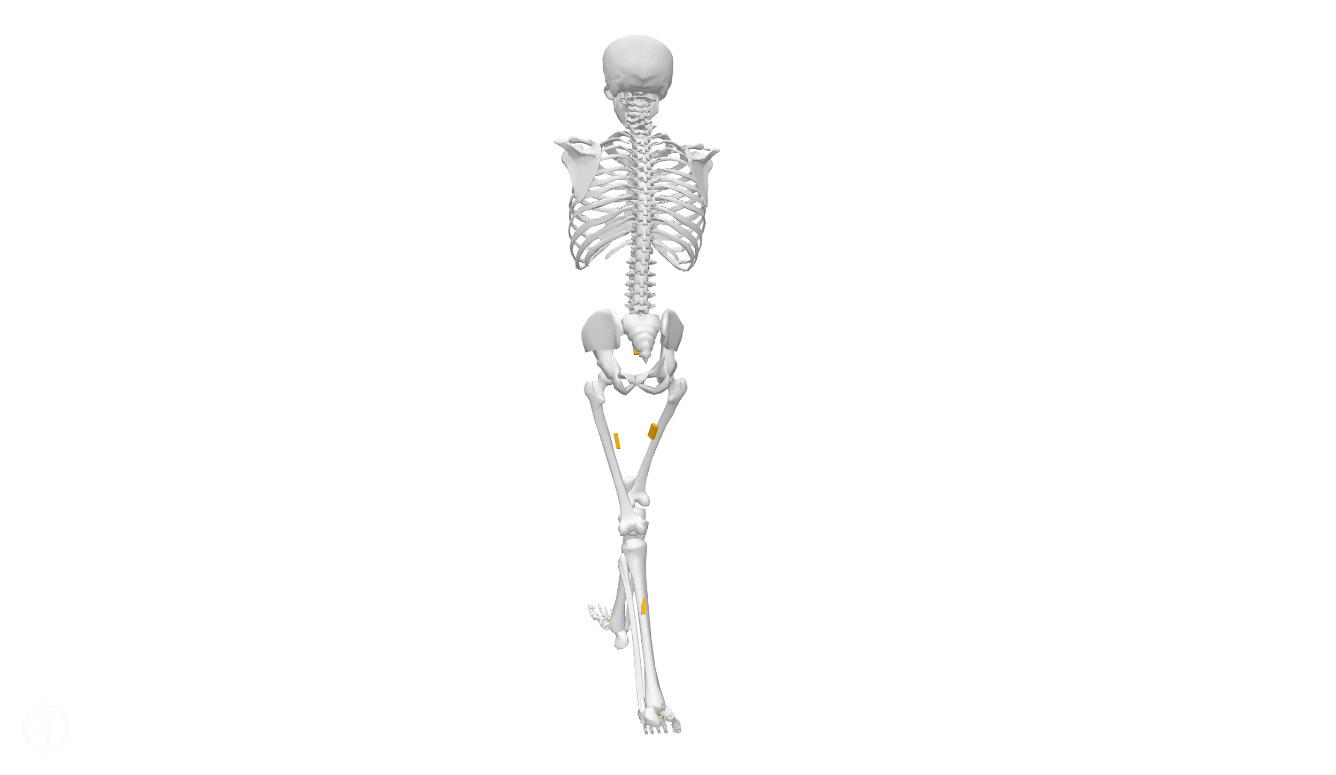
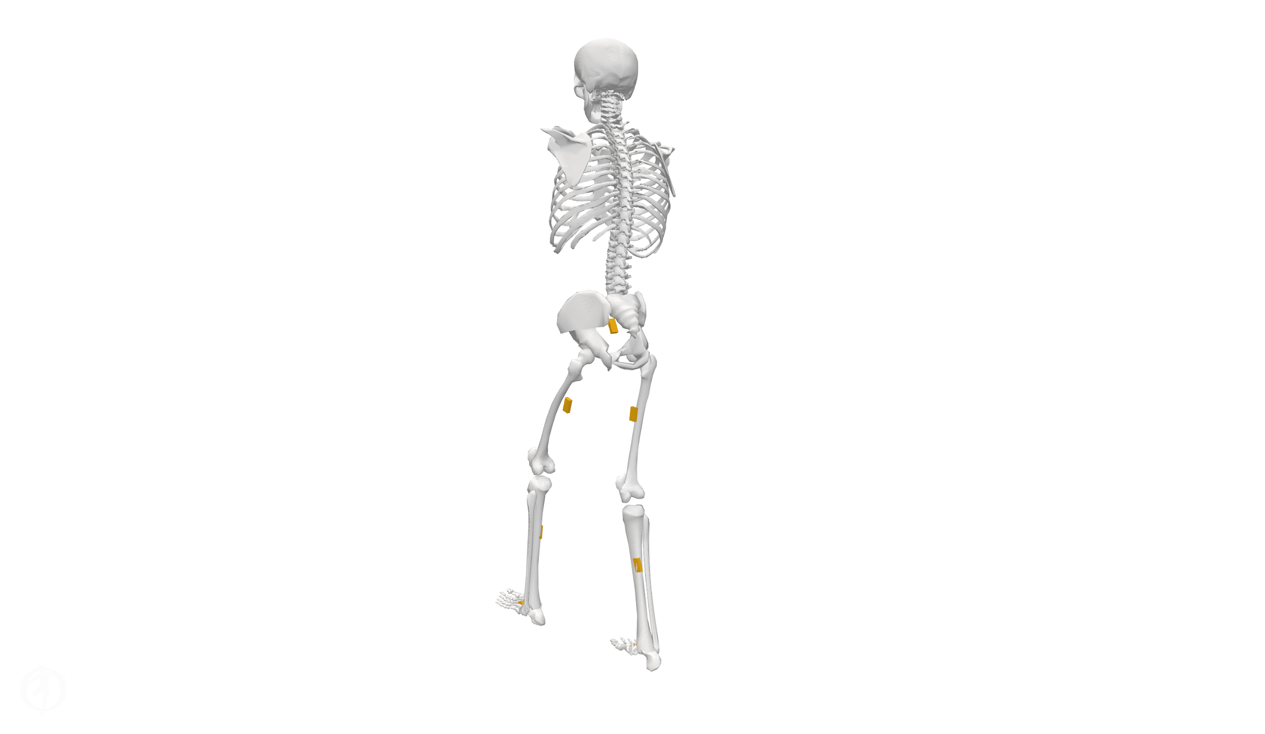
Estimation of Lower-limb Joint Kinematics with Inertial Measurement Units
Team 1
Alexander Kyu👨‍💻, Ronin Zhang👨‍🔧, Vaishak Harish🧑‍🔬, and Vu Phan 👨‍🔧
Final Presentation
Carnegie Mellon University
Spring 2023

Slide 2
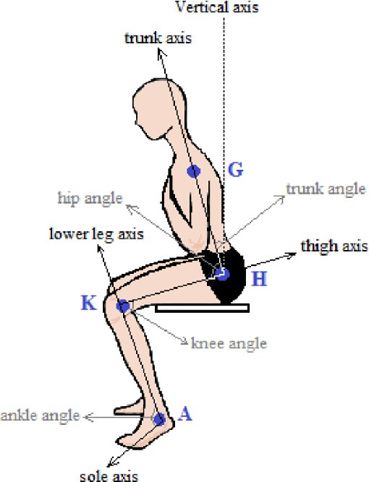
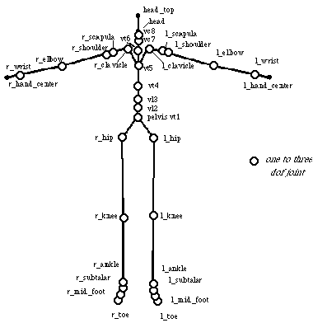
What is joint kinematics?
https://www.euclideanspace.com/physics/kinematics/joints/index.htm
https://www.researchgate.net/publication/312422406_Influence_of_time_restriction_20_minutes_and_946_months_of_visual_information_on_angular_displacement_during_the_sit-to-stand_STS_task_in_three_planes/figures?lo=1
Notes:
Joint kinematics is used to study the range of motion of the joints in the body. It can be described in terms of various parameters, such as joint angle, position, velocity, and acceleration
the joint's velocity and acceleration during different activities, such as walking or climbing stairs.
measuring the rate at which the knee joint angle changes over time (velocity) and the rate at which the joint's velocity changes over time (acceleration).
These parameters are used to quantify the movement of the joint and can provide important information.
Joint kinematics refers to the study of the motion of the joints in the body. In other words to assess the range of motion (ROM)
Joint kinematics is best described in terms of joint angles, it’s position, velocity and acceleration.
joint angle, position, velocity, and acceleration. These parameters are used to quantify the movement of the joint and can provide important information.
To better understand this concept, let's use the knee joint as an example.
The knee joint primarily allows for flexion and extension movements (bending and straightening of the leg). Let's say a physical therapist wants to assess the range of motion (ROM) of a patient's knee joint after a surgery. They would use joint kinematics to do so.
First, they would measure the joint angles at various positions, such as when the leg is fully extended (0 degrees) and when it is fully flexed (approximately 130-150 degrees, depending on the individual). This would provide information about the patient's ROM.
Next, they might evaluate the joint's velocity and acceleration during different activities, such as walking or climbing stairs. This would involve measuring the rate at which the knee joint angle changes over time (velocity) and the rate at which the joint's velocity changes over time (acceleration).
These parameters could help the therapist identify any abnormal movement patterns, assess the patient's progress during rehabilitation, and adjust the therapy plan accordingly.

Slide 3
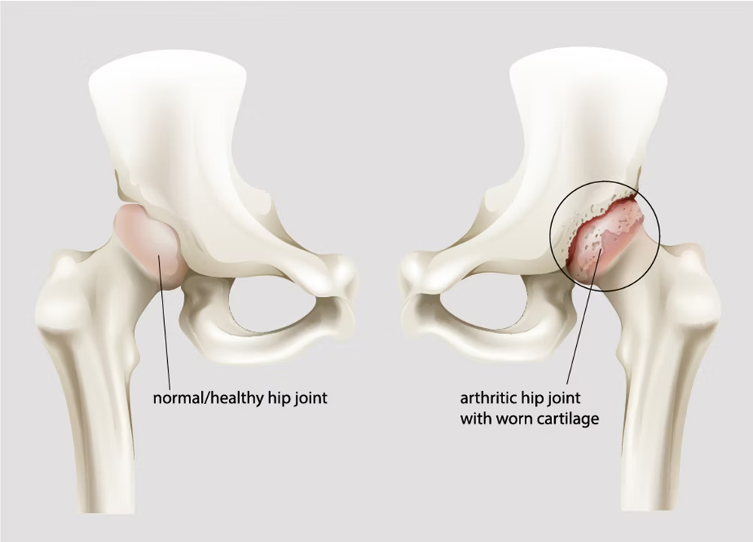
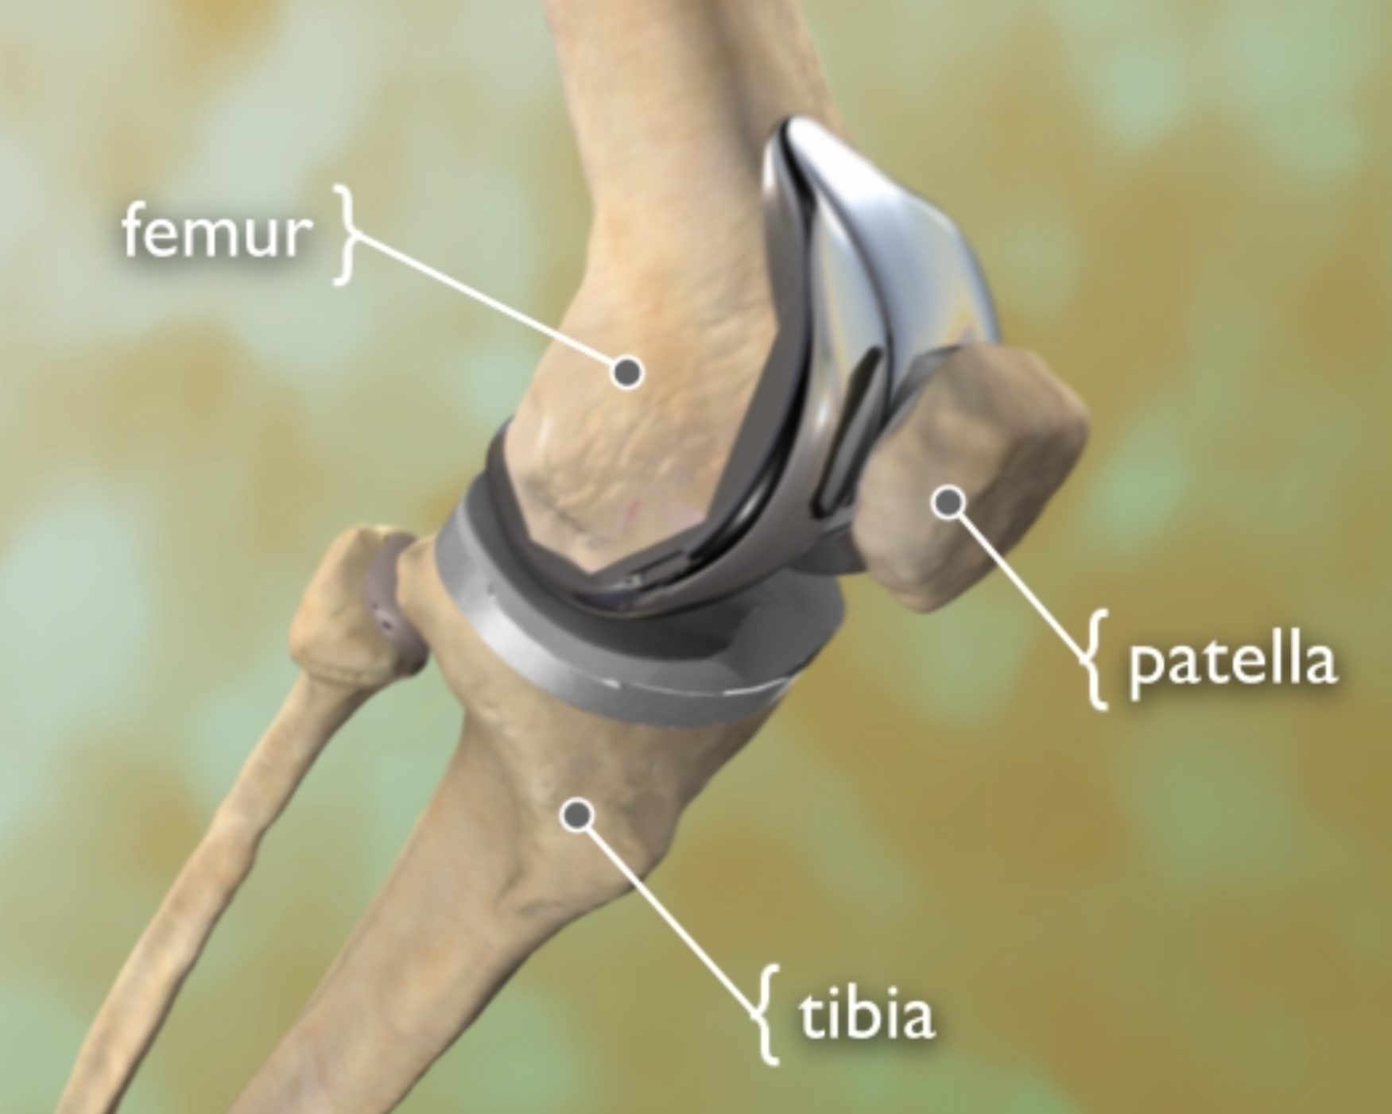
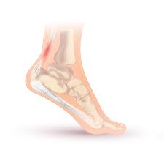
Why do we need joint kinematics estimation?
https://stiwell.medel.com/orthopaedics/hip-arthrosis
https://orthoinfo.aaos.org/en/treatment/total-knee-replacement-animation/
https://en.wikipedia.org/wiki/Achilles_tendinitis
Notes:
Physiotherapists use this information to create tailored exercise programs and track progress.
After surgeries like ACL reconstruction or total joint replacement, would have their joint angles and range of motion during activities such as walking or running, clinicians can better understand how the joint functions in real-world situations. This can help identify areas of weakness or limitations that may need to be addressed in therapy.
To better understand this concept, let's use the knee joint as an example.
The knee joint primarily allows for flexion and extension movements (bending and straightening of the leg). Let's say a physical therapist wants to assess the range of motion (ROM) of a patient's knee joint after a surgery. They would use joint kinematics to do so.
First, they would measure the joint angles at various positions, such as when the leg is fully extended (0 degrees) and when it is fully flexed (approximately 130-150 degrees, depending on the individual). This would provide information about the patient's ROM.
Next, they might evaluate the joint's velocity and acceleration during different activities, such as walking or climbing stairs. This would involve measuring the rate at which the knee joint angle changes over time (velocity) and the rate at which the joint's velocity changes over time (acceleration).

Slide 4
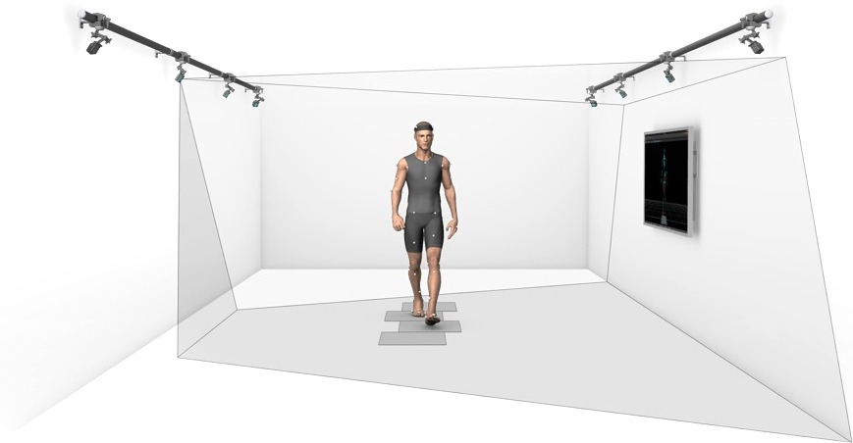
Traditional approaches use cumbersome and expensive marker-based systems for motion capture

Slide 5
Study aims
01
Accuracy of Full-Body Kinematics
State Estimation Filters: Madgwick, Mahony, Complementary, EKF, Xsens
Biomechanical Modelling: OpenSense
02
Sensitivity to Sensor-to-Body Calibration Errors
Evaluate the impact of sensor placement errors on estimation accuracy
03
Sensitivity to Skin-motion Artifact
Investigate the influence of skin-motion artifact on the quality of kinematic estimations
Notes:
Aim1: different estimation methods may perform differently under various conditions, affecting the quality of full-body kinematic data.
Q1: What is the best sensor fusion algorithms for estimating joint kinematics using IMUs?
Q2: How does biomechanical modeling improve the performance of joint kinematics estimation with IMUs?
Aim2: In real-world scenarios, sensor placement errors are common and can significantly influence the quality of kinematic data.
Q3: How does sensor-to-body misalignment affect the estimation accuracy?
Aim3: The performance of IMU-based estimation methods can be affected by quality of the input data, which is influenced by the signal-to-noise ratio
Q4: How does skin motion and other soft tissues artifacts impact the estimation accuracy?

Slide 6
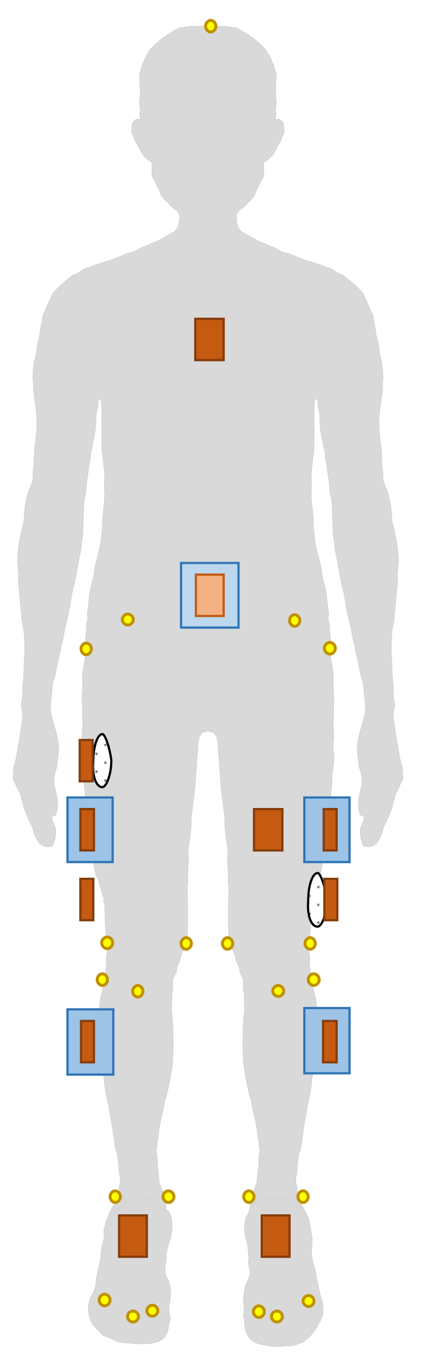
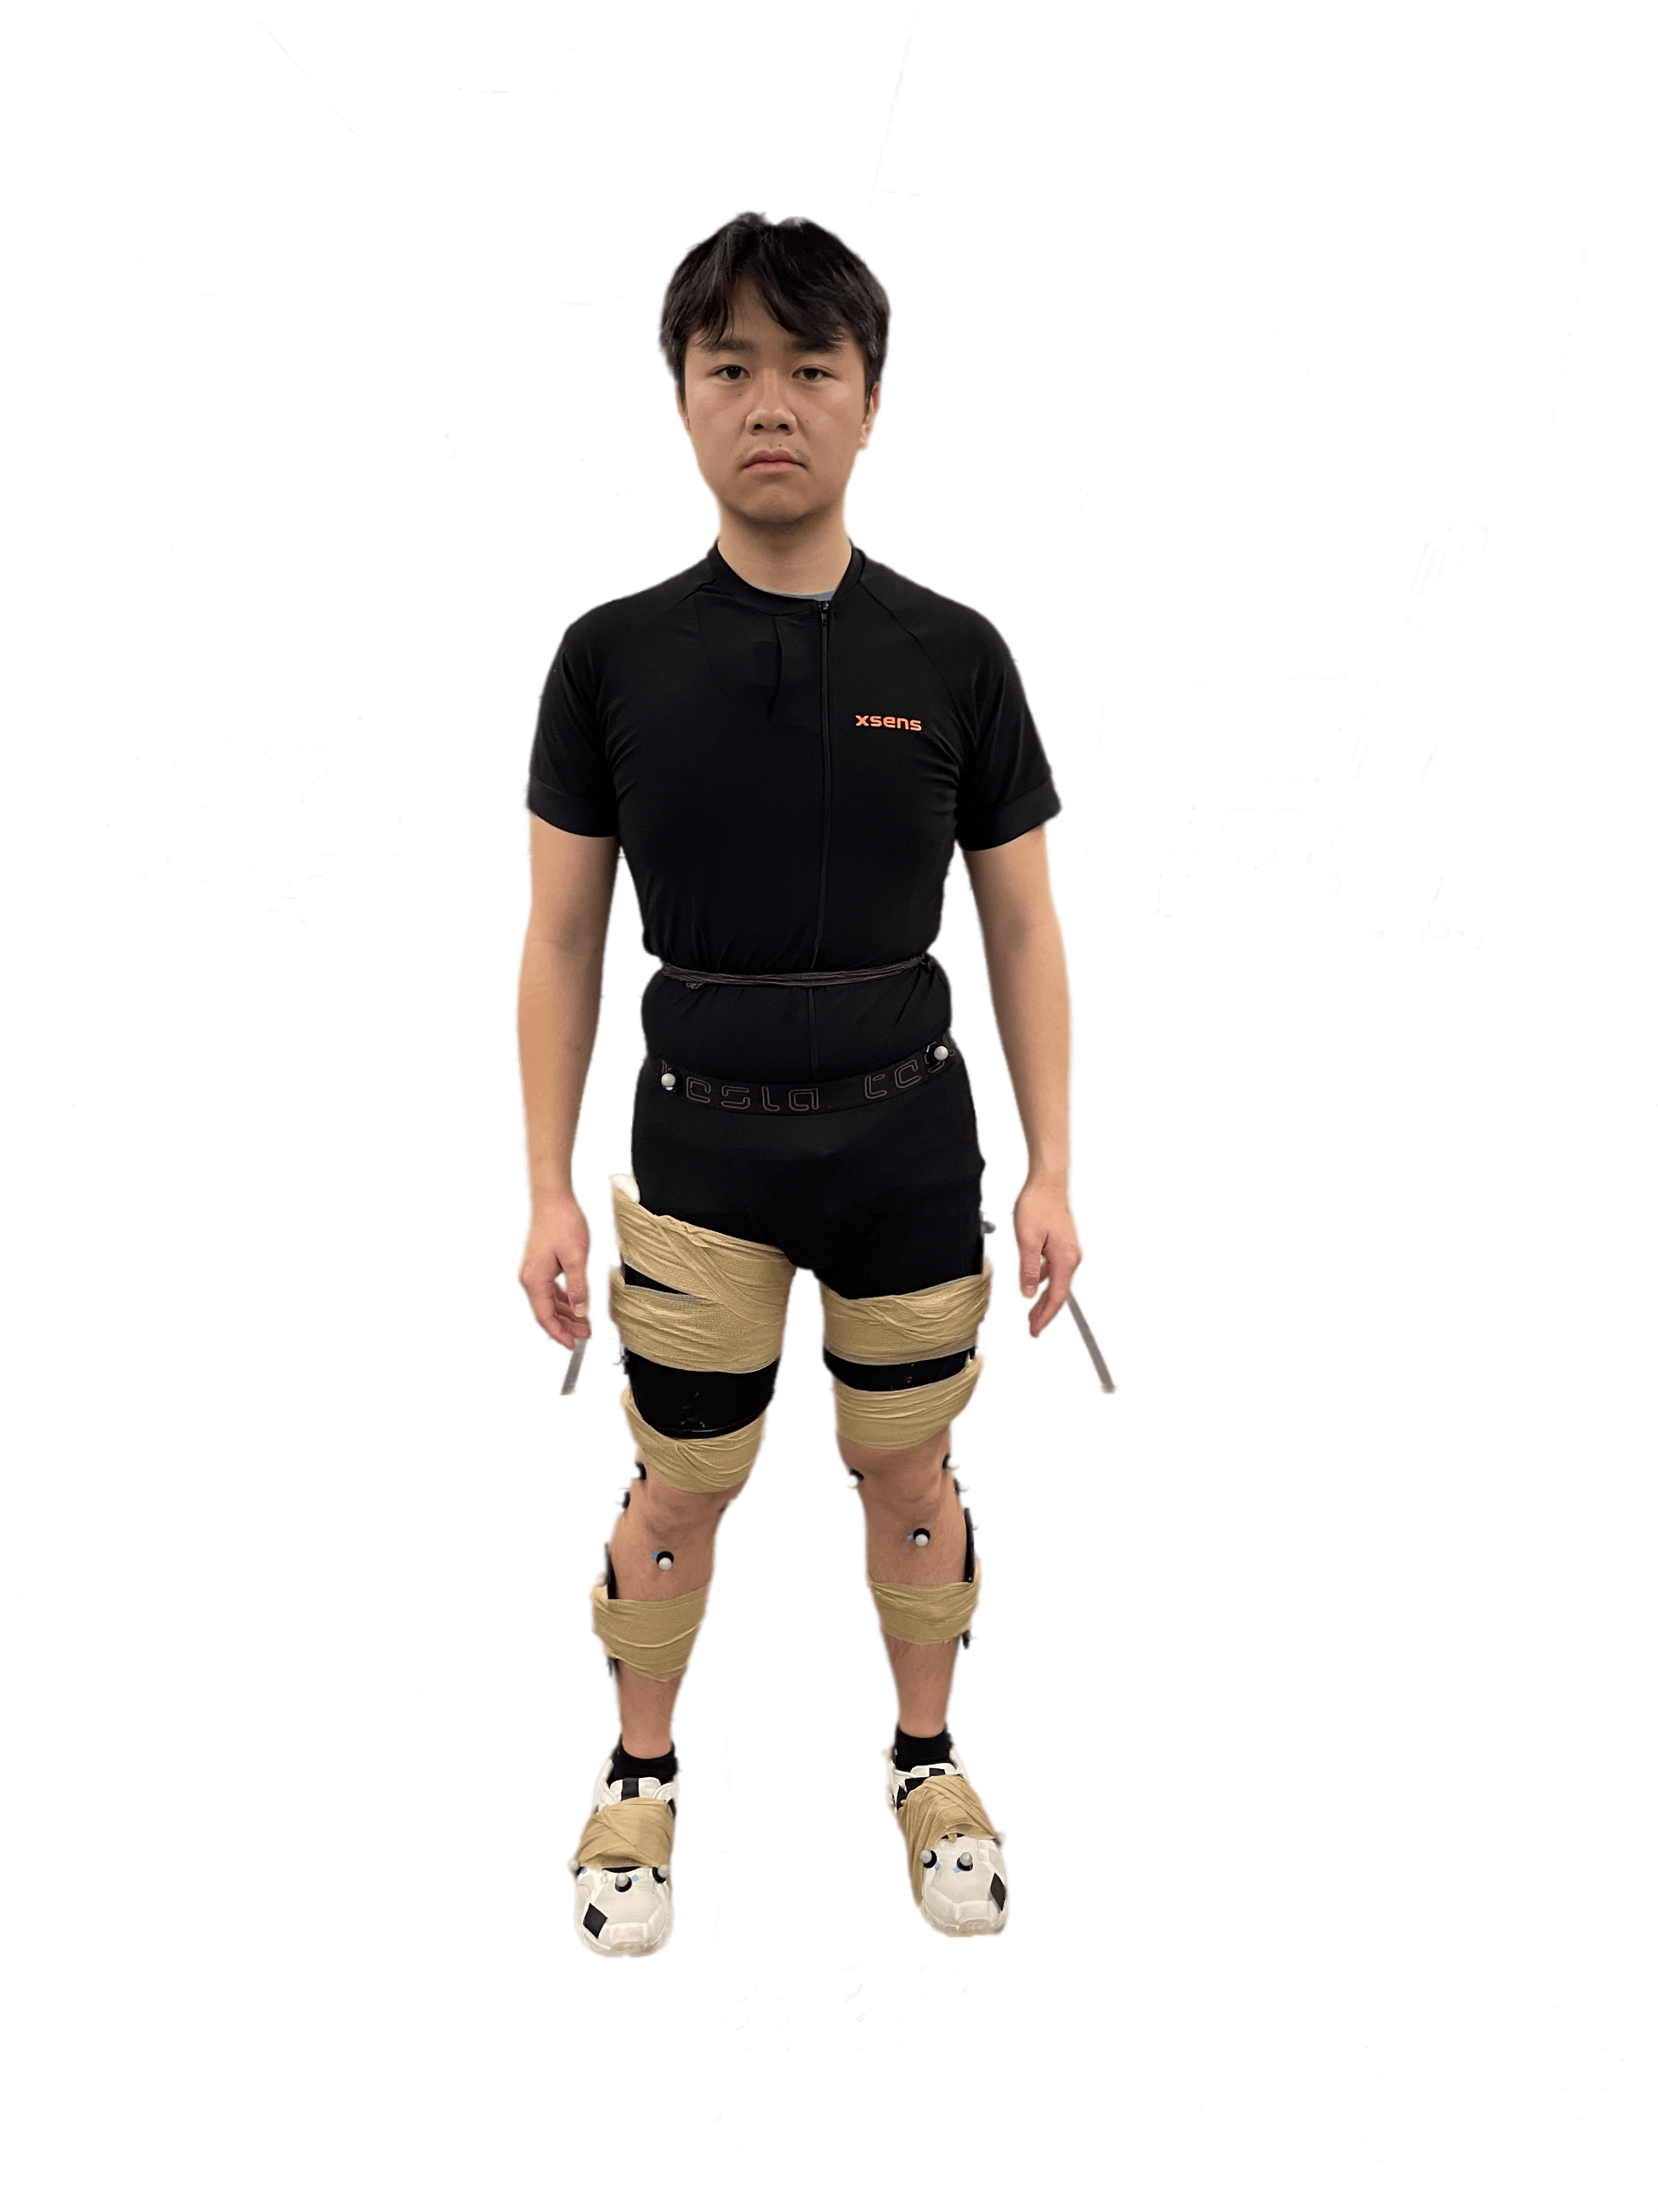
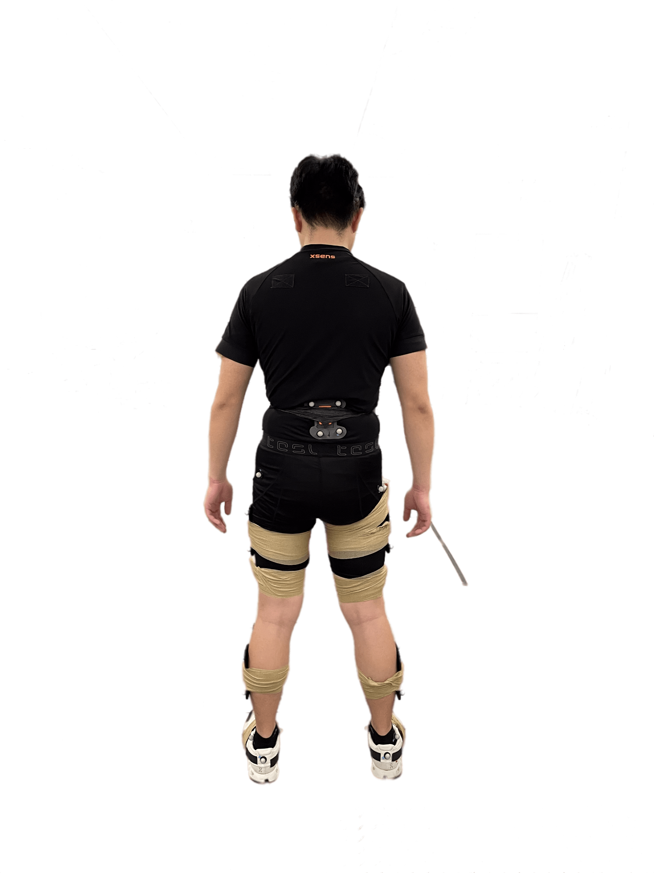
Experimental setup
Cluster
Xsens IMU
Cotton pad
Chest
Marker
Pelvis
R thigh 3
L thigh 2
R thigh 1
L thigh 1
R thigh 2
L thigh 3
R shank
L shank
R foot
L foot
Planned setup
Real setup

Slide 7
Different sensor configurations for different aims of this study
Aim 1
Aim 2
Aim 3
Accuracy of lower-body kinematics using (1) state- estimation filters, and (2) combination of state-estimation filters and biomechanical model
Sensitivity analysis of sensor-to-body calibration errors
Sensitivity analysis of skin motion artifacts in different tasks
Hip angles
Hip angles
(1, 2)
Hip angles
(1, 2, 3)
Same orientation, different attachment
Knee angles
Knee angles
(1, 2)
Knee angles
(1, 2, 3)
Ankle angles

Slide 8
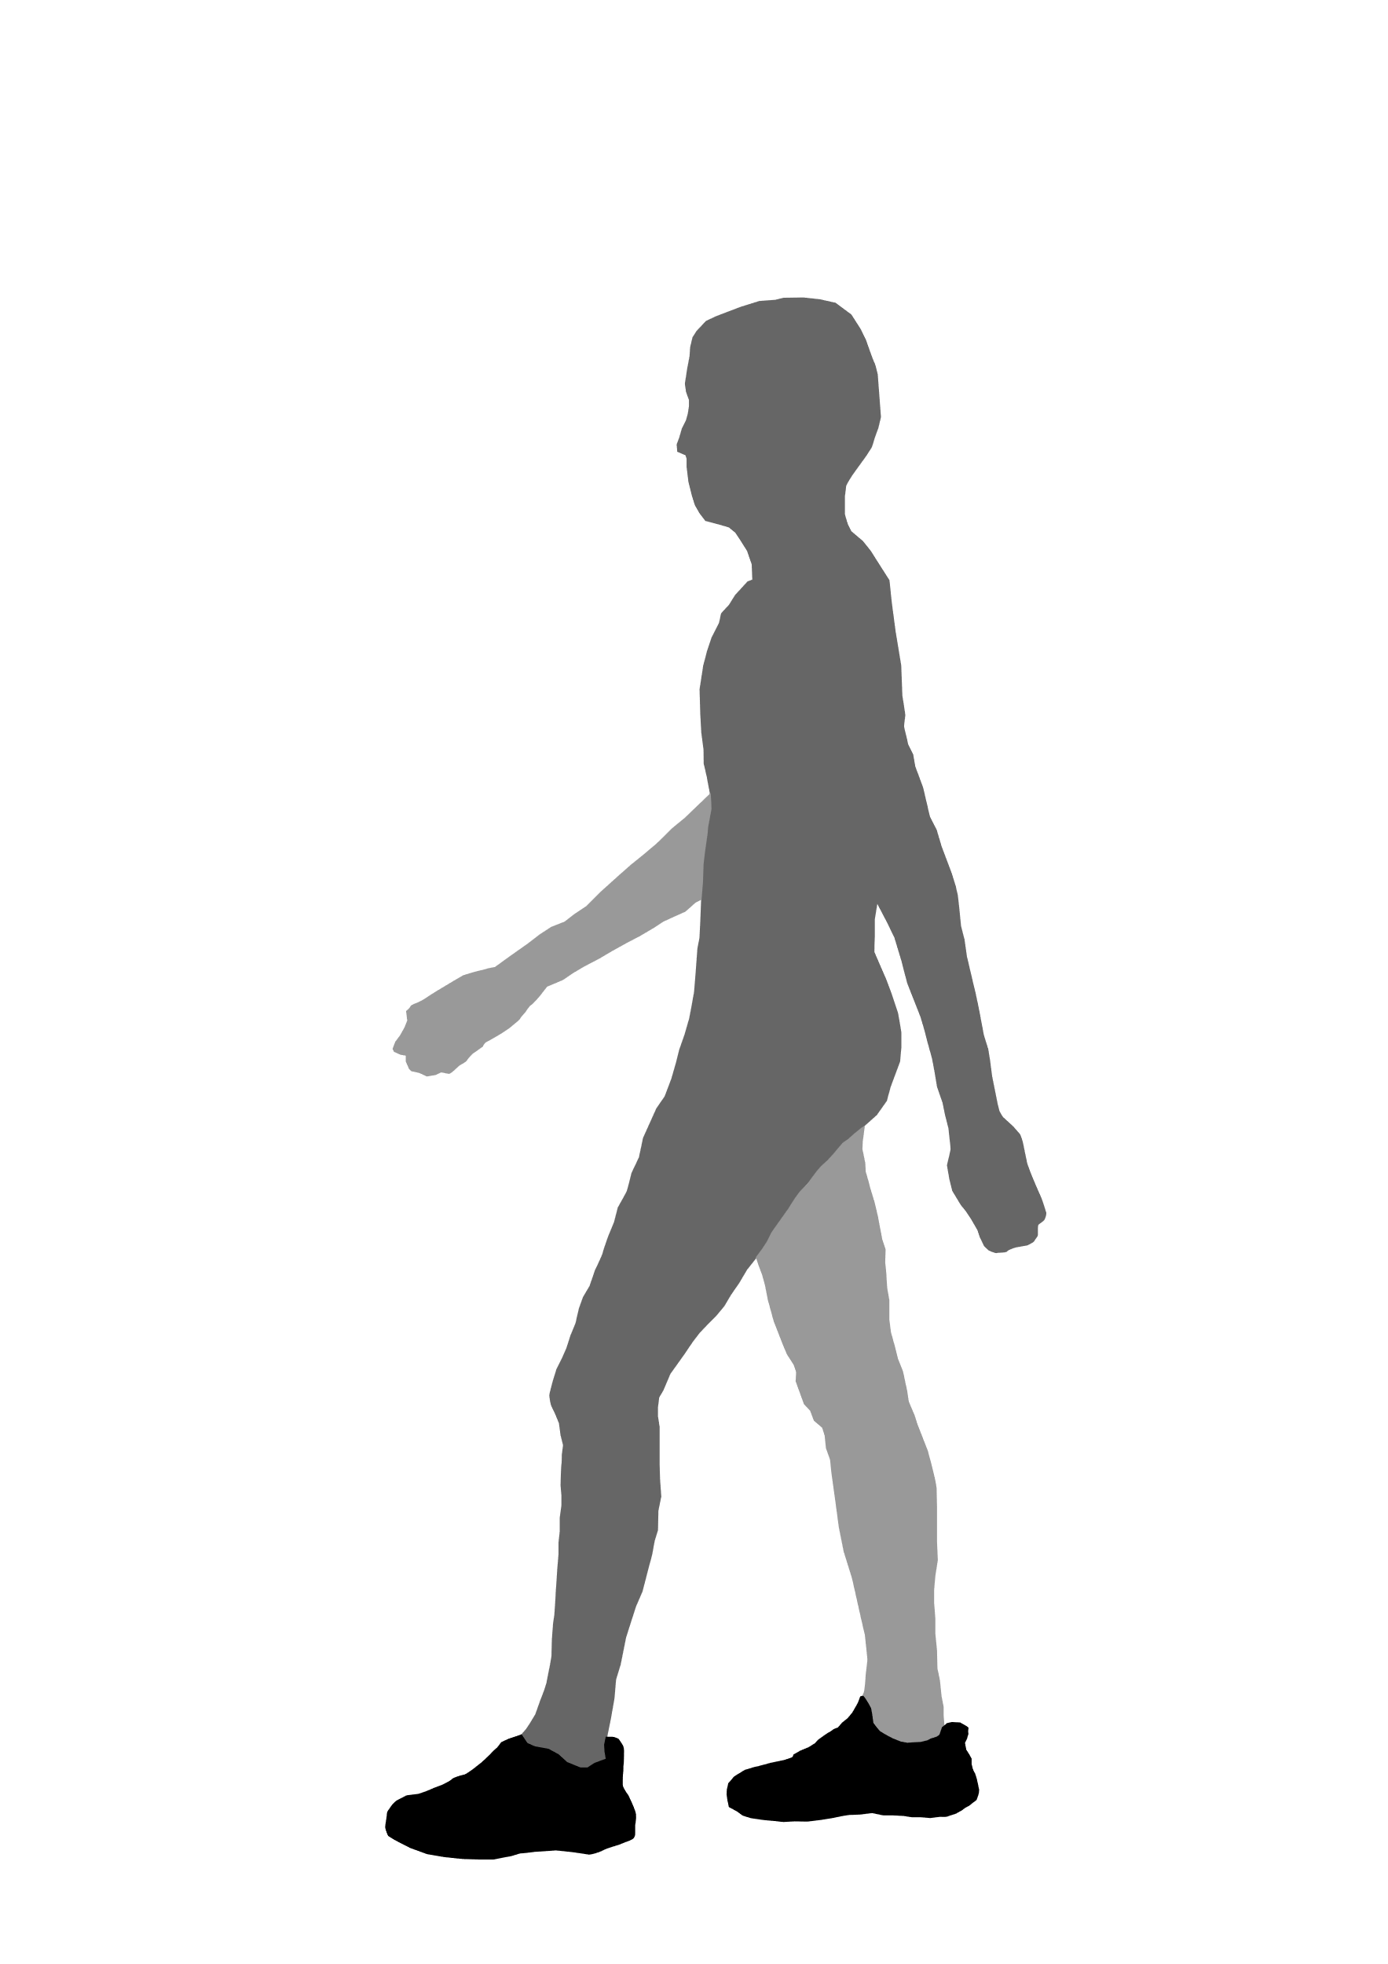
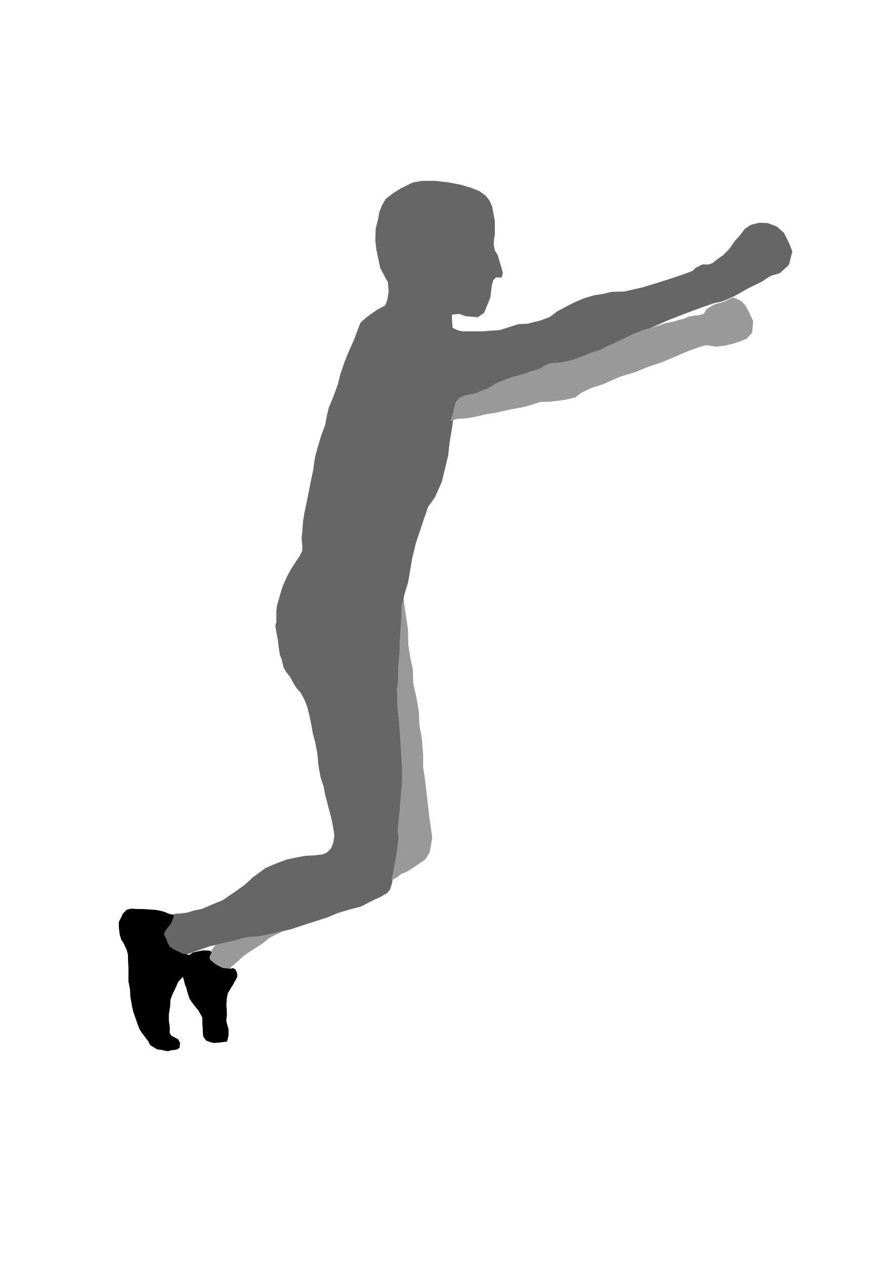
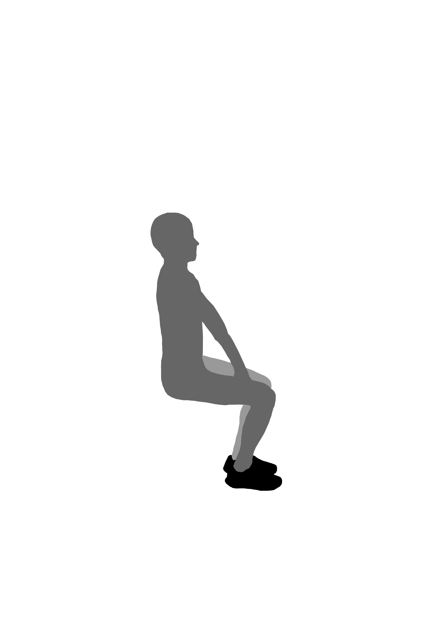
Various tasks were performed, but only sit-to-stand provided high-quality data
N-pose
(5 seconds)
Vertical jump
(3 times)
Sit down
Overground walking in 10 minutes
10 times
10 times
10 times
Relax
(4 minutes)
Relax
(4 minutes)

Slide 9
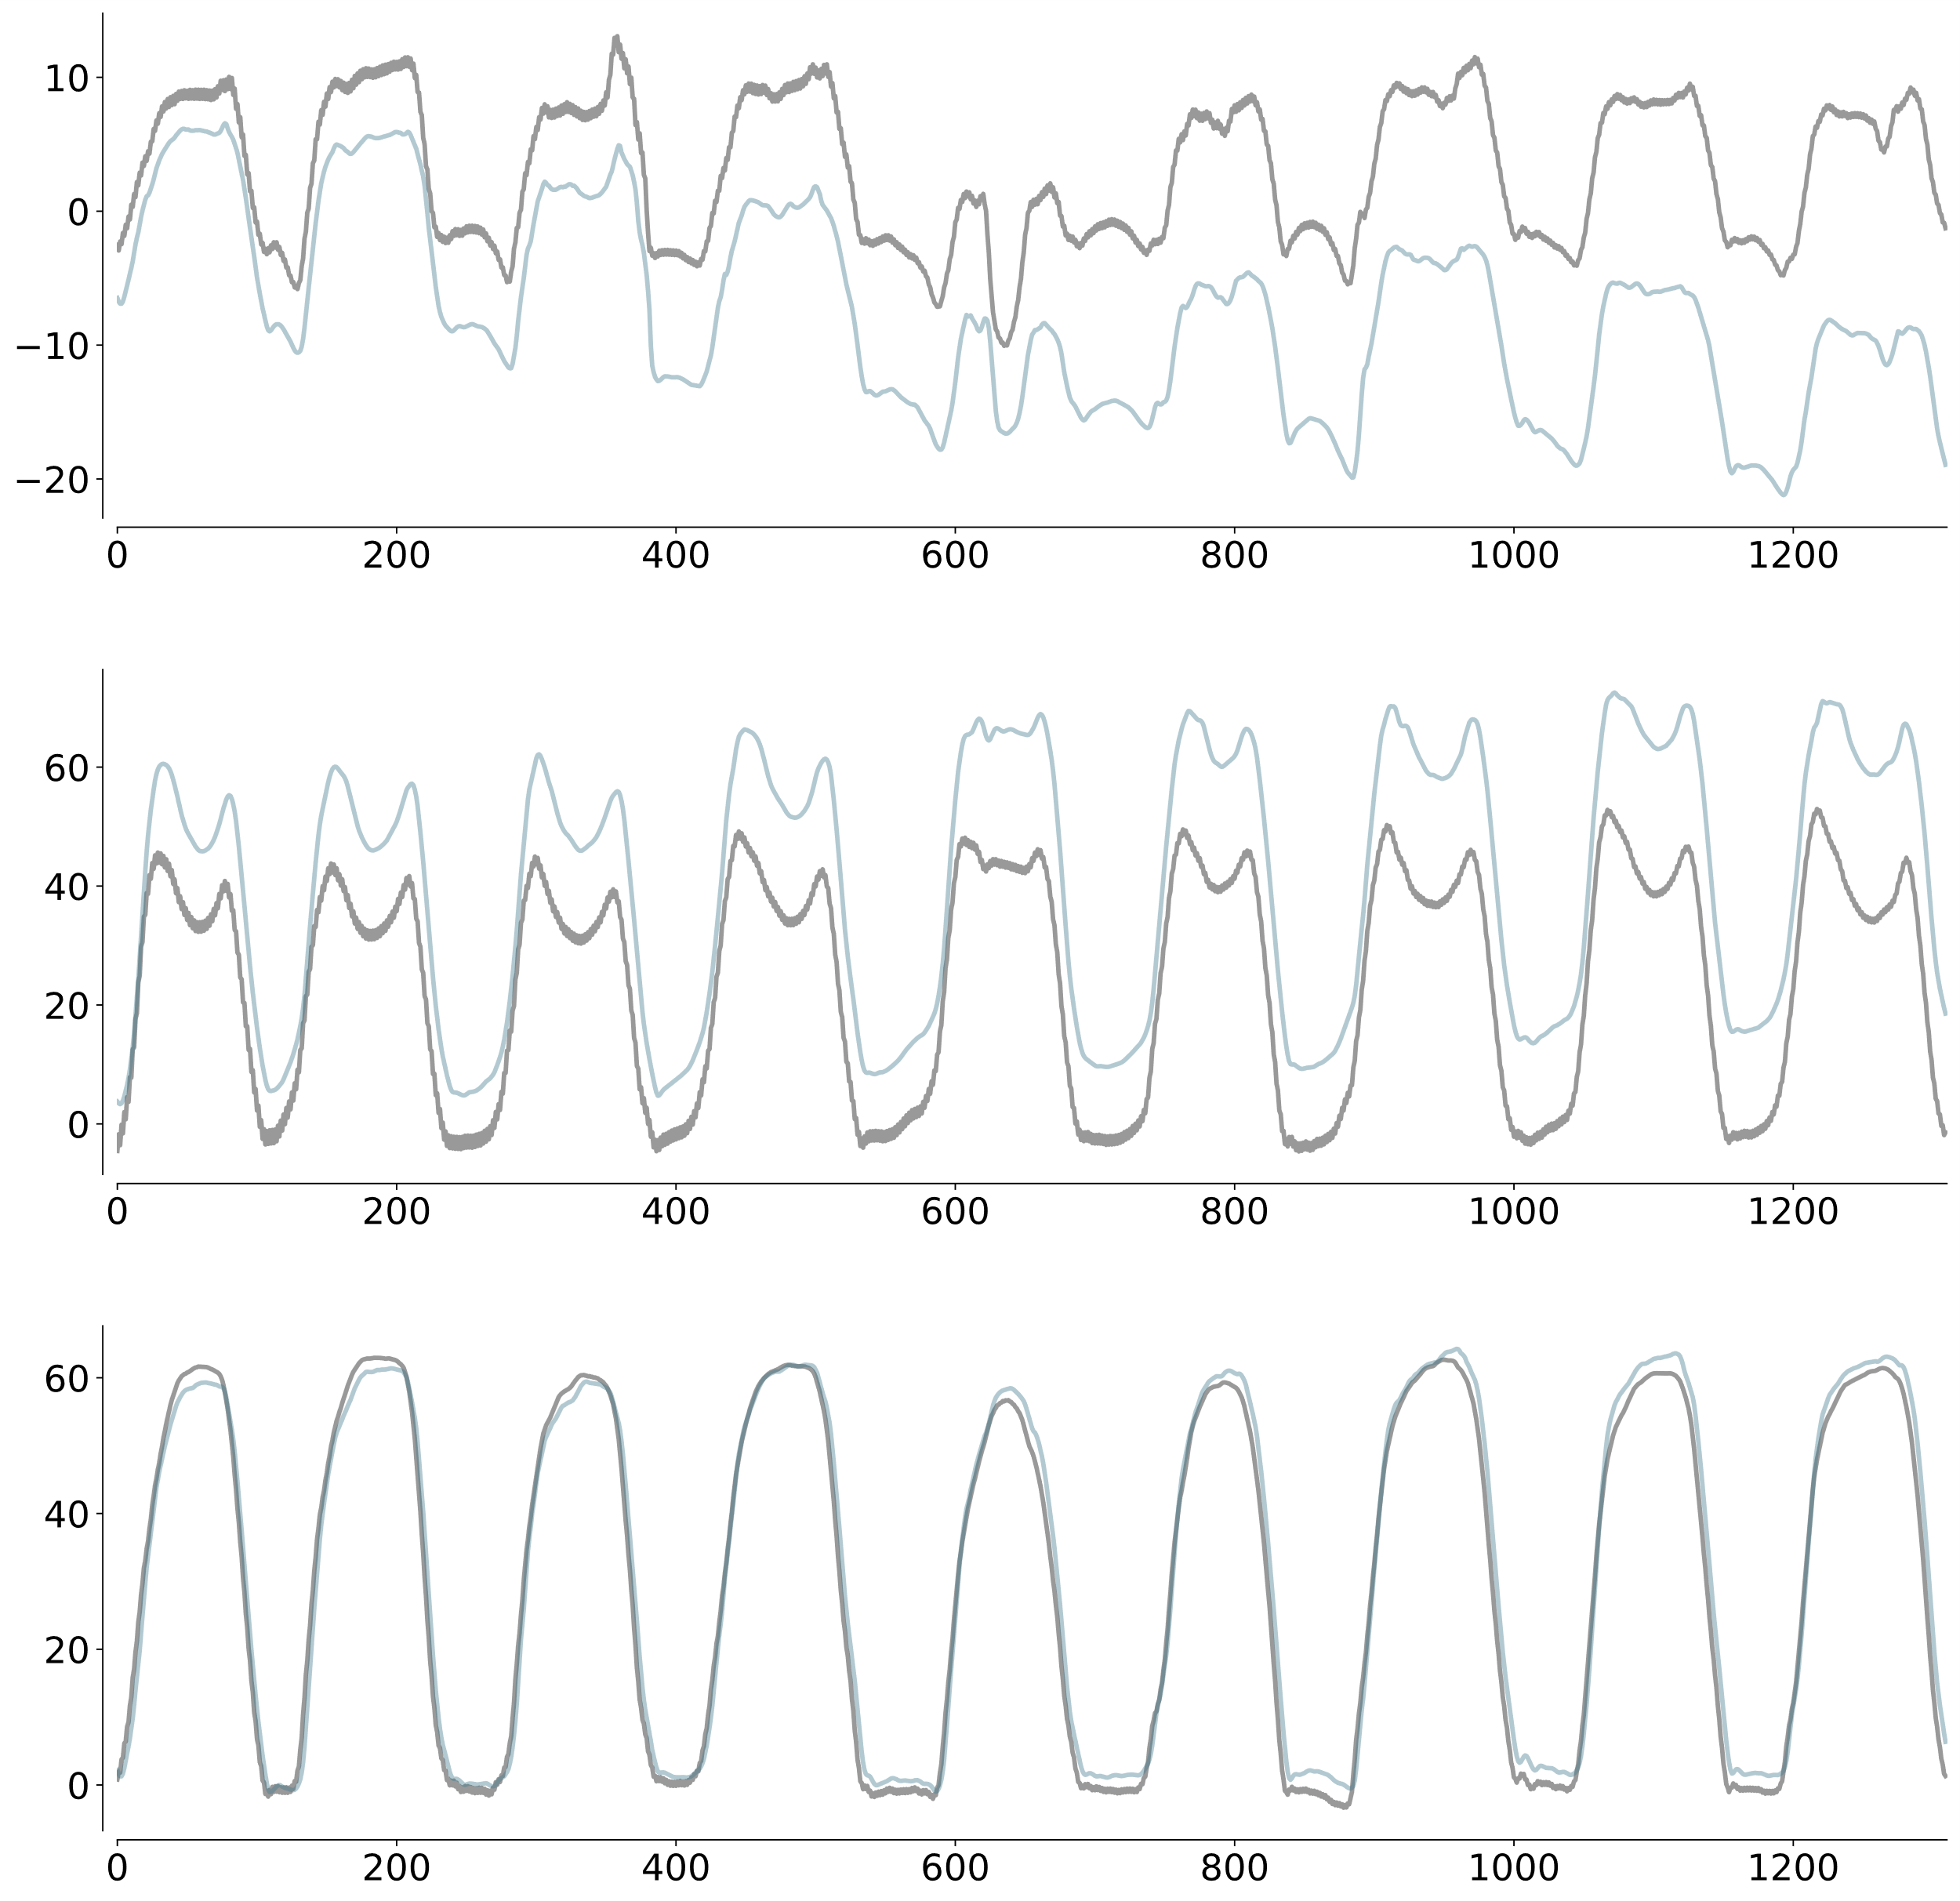
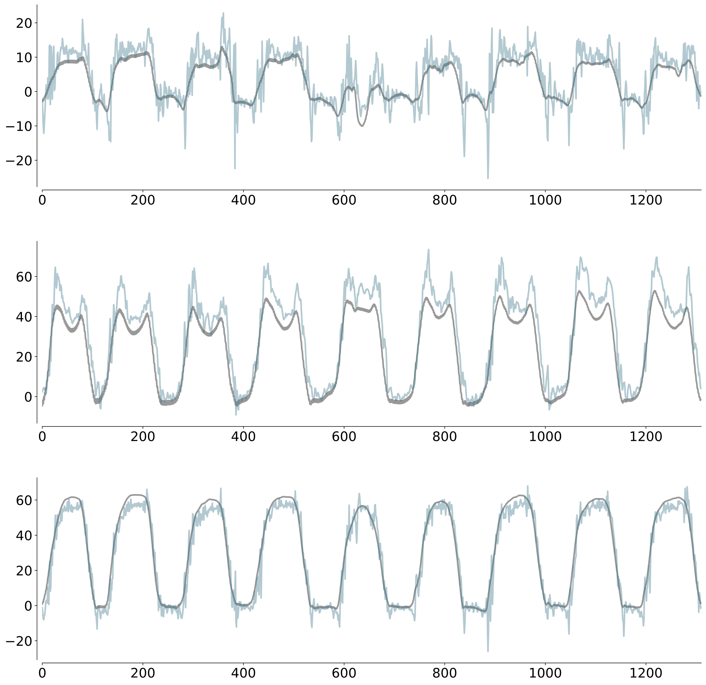
Different sensor fusion methods were manually tuned
Alpha = 0
Alpha = 1
Ankle angle (º)
Hip angle (º)
Knee angle (º)
Mocap
Complementary filter

Slide 10
How generalizable is tuning?
Preliminary observation
Offset on the estimation of EKF that can be resolved by tuning its parameters
Decision
Tuned all filters before performance evaluation
Notes:
So now let's talk in more details on our results and findings.Our first question that we had was: How generalizable is tuning of our state-estimation filters? From our early process, we noticed a large offset on the joint angle estimation when using our EKF filter and saw that tuning the parameters showed improvement and reduction in the RMSE. Based on this, we decided to tune all filters before performance evaluation.

Slide 11
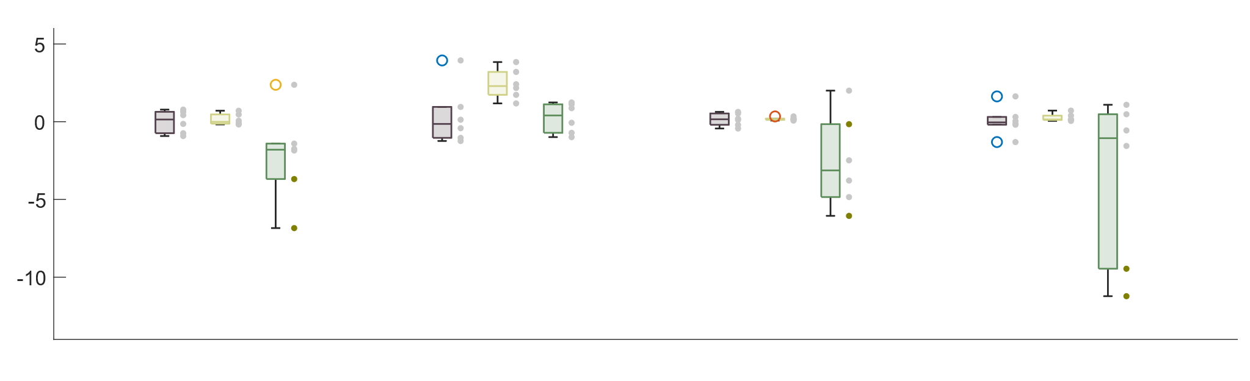
EKF tuning may be generalizable to different scenarios, e.g., across subject, duration, and population
Madgwick filter
Ankle angles (individual subject)
Mahony filter
Other angles (individual subject)
EKF filter
STS vs. walking
Subject 1 vs. 4
Beginning vs. ending
Healthy vs. ACL
dRMSE (º)
Across subject
Across tasks
Across duration
Across population
Notes:
So, more specifically, we wanted to see if tuning was generalizable across subjects, tasks (sit-to-stand vs walking), time (across the 3 trials we conducted), and populations (how does a subject with and without ACL strain)? Using the tuning parameters from s1, we evaluated how different scenarios' joint estimation RMSE's changed after tuning. Here we are showing change in RMSE after tuning.
In all scenarios except for time, the EKF filter tuning seemed generalizable as there was consistent RMSE improvement. However, we would need more data to verify this.

Slide 12
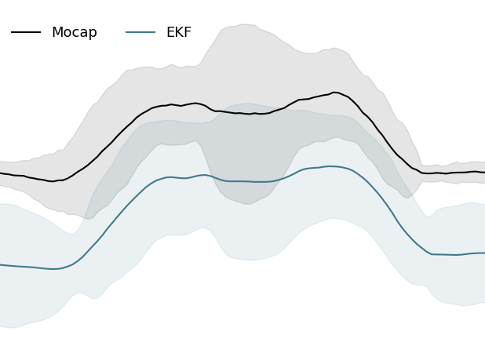
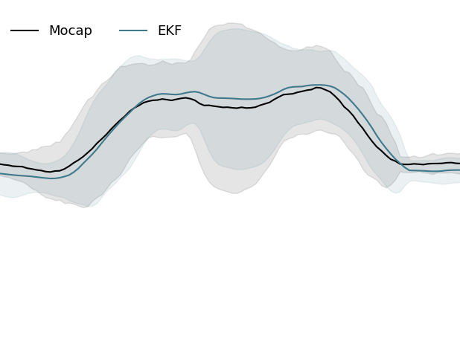
Tuning may be beneficial for specific joint angles
Madgwick filter
Before tuning
After tuning
Ankle angles (individual subject)
Mahony filter
Other angles (individual subject)
EKF filter
STS vs. walking
Subject 1 vs. 4
Beginning vs. ending
Healthy vs. ACL
dRMSE (º)
Across subject
Across tasks
Across duration
Across population
Notes:
When looking at the data more granularly, we see that for the ankle joint, the EKF filter tuning was more consistent across all scenarios.

Slide 13
Which sensor fusion algorithm perform the best?
Would the biomechanical model improve the estimation?
Preliminary observation
Traditional complementary filter resulted in very poor estimation
Decision
Removed from the analysis
Notes:
Our second and third questions were: Which sensor fusion algorithm perform the best? and Would the biomechanical model improve the estimation? In our preliminary observations, we noticed that the traditional complementary filter resulted in very poor estimation and so we removed that filter from our analysis.

Slide 14
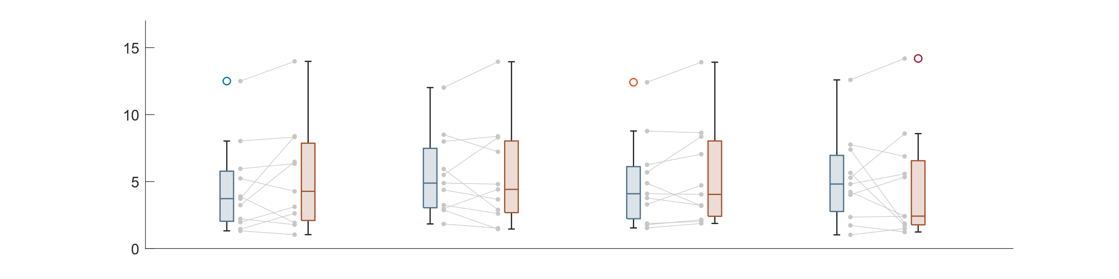
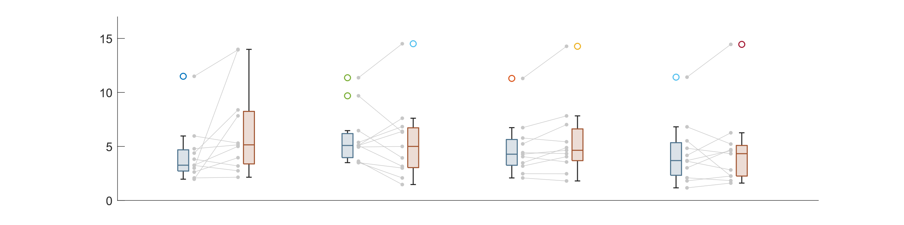
Sensor fusion methods have similar performance, while Xsens built-in filter may not be tuned for long-duration recordings
At the beginning
At the end
Individual trial
RMSE (º)
Without OpenSense
RMSE (º)
With OpenSense
Xsens
Madgwick
Mahony
EKF
Notes:
First, we noticed that all sensor fusion methods have similar performance, which is in agreement with the Opensense paper. There wasn't any one filter among these four that had significantly smaller RMSEs than the others. However, with the Xsens filter, we did notice that the RMSE variability among the joints increased over time. So it is possible that the XSens built-in filter is not tuned for long-duration experiments and should be used with caution in these long-duration experiments.

Slide 15
No clear evidence of using biomechanical model to improve estimation performance
At the beginning
At the end
Individual trial
RMSE (º)
Without OpenSense
RMSE (º)
With OpenSense
Xsens
Madgwick
Mahony
EKF
Notes:
Second, when looking at results with and without biomechanical modelling, there was not clear evidence that using biomechanical modelling (opensense) improved estimation performance, which is in disagreement with the Opensense paper.

Slide 16
How does sensor misplacement and skin/soft motion artifacts affect the estimation accuracy?
Would the biomechanical model (from OpenSense) be helpful?
Preliminary observation
Trend across sensor fusion methods (e.g., increase in error as a sensor is misplaced, etc.)
Decision
Selected Xsens built-in filter (i.e., standard, commonly used, etc.)

Slide 17
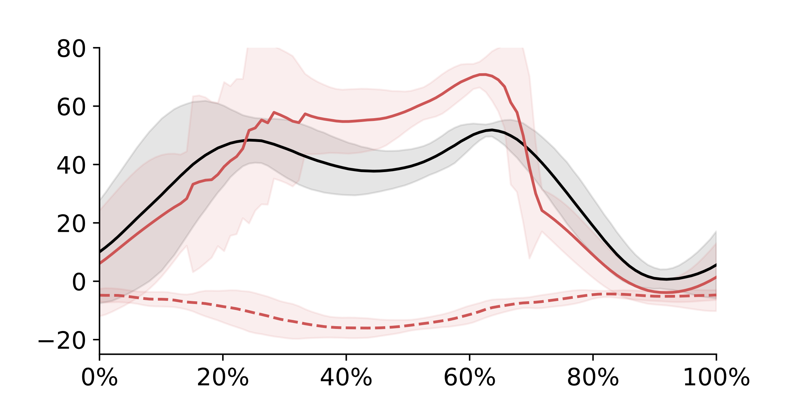
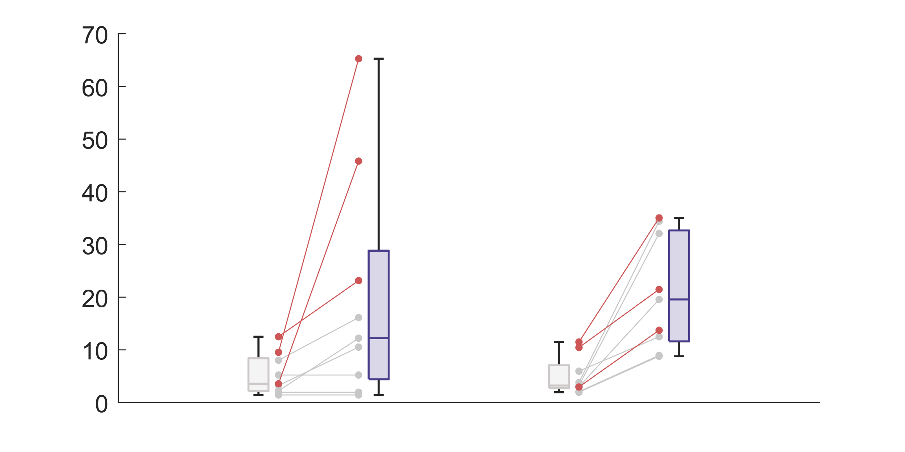
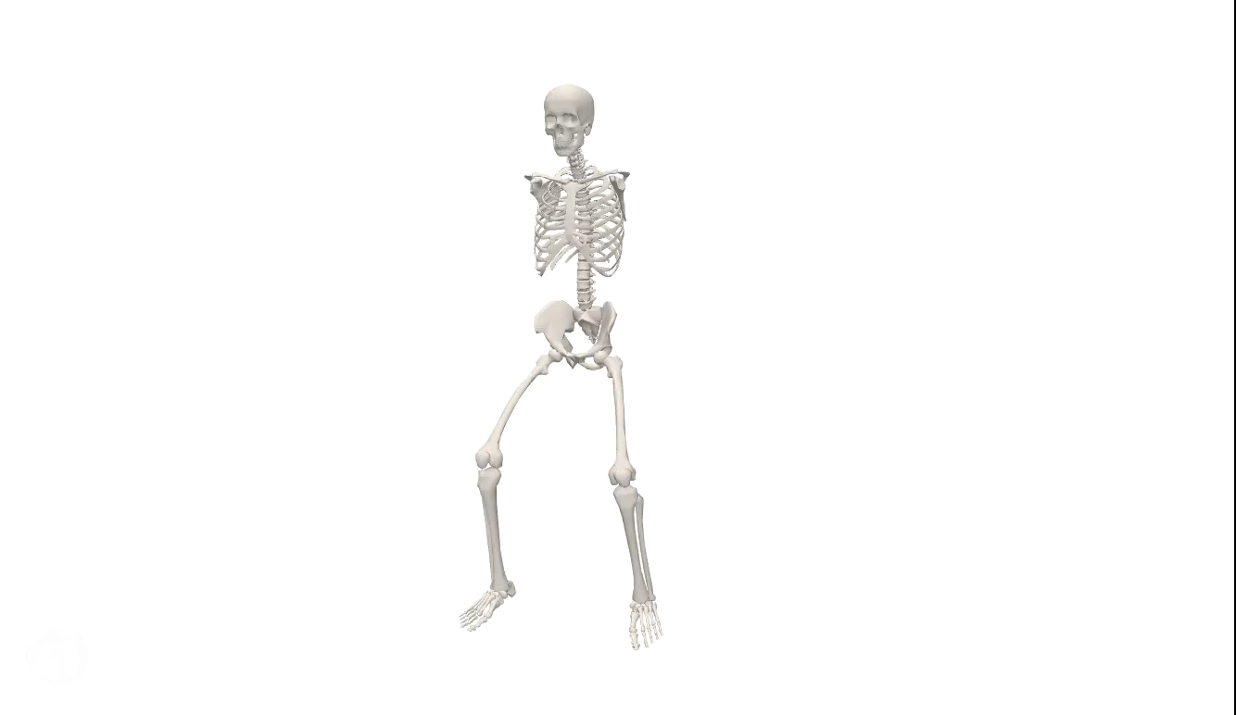
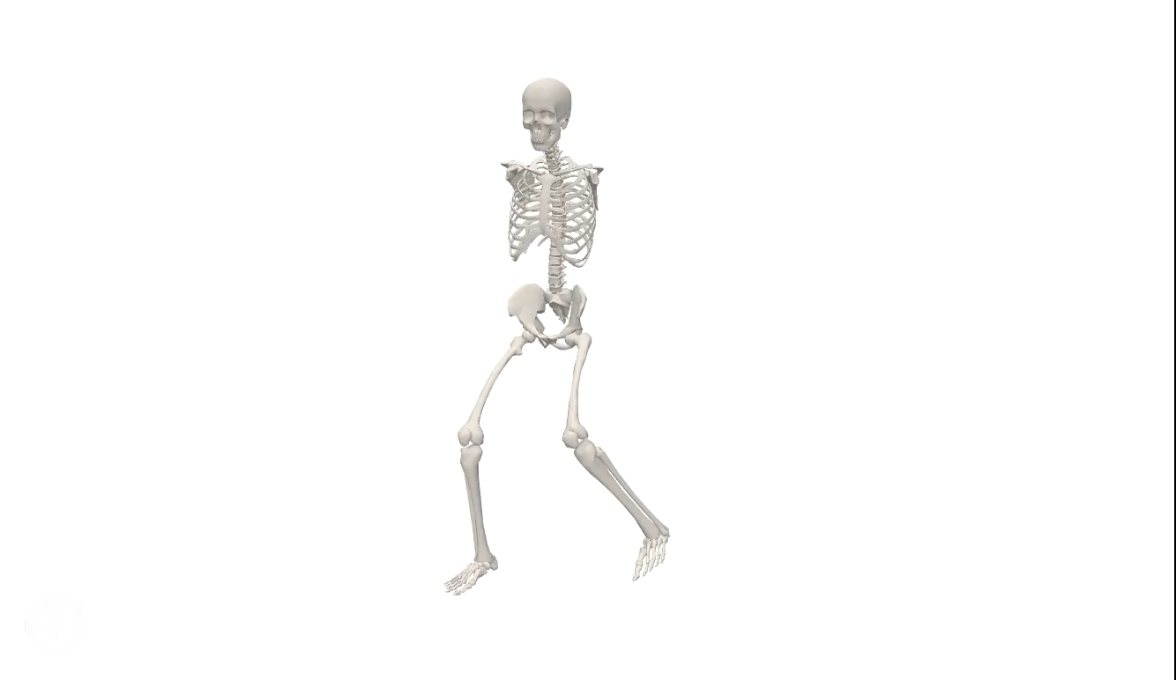
OpenSense improves the estimation of hip angles given sensor misplacement
With OpenSense
Normal condition
Sensor misplacement
Ground truth
Angle (º)
Hip angles (individual subject)
Other angles (individual subject)
Without OpenSense
Further look on subject 4
Repetition period
Normal condition
Sensor misplacement
RMSE (º)
Without OpenSense
With OpenSense

Slide 18
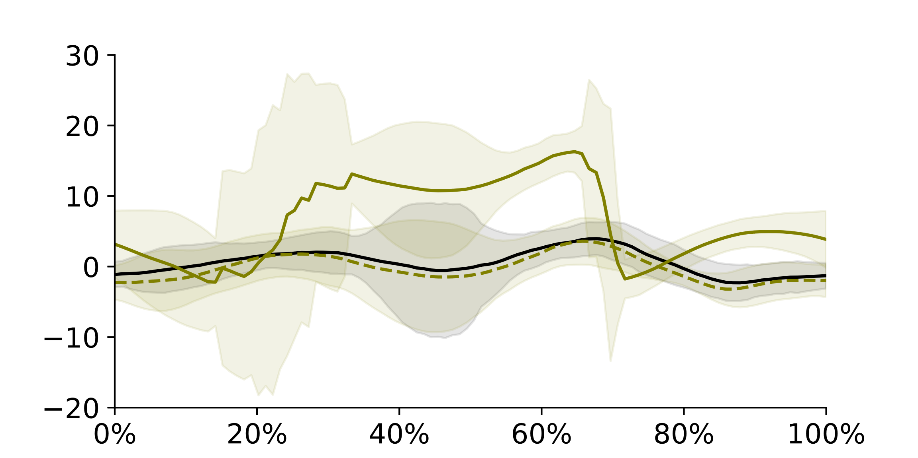
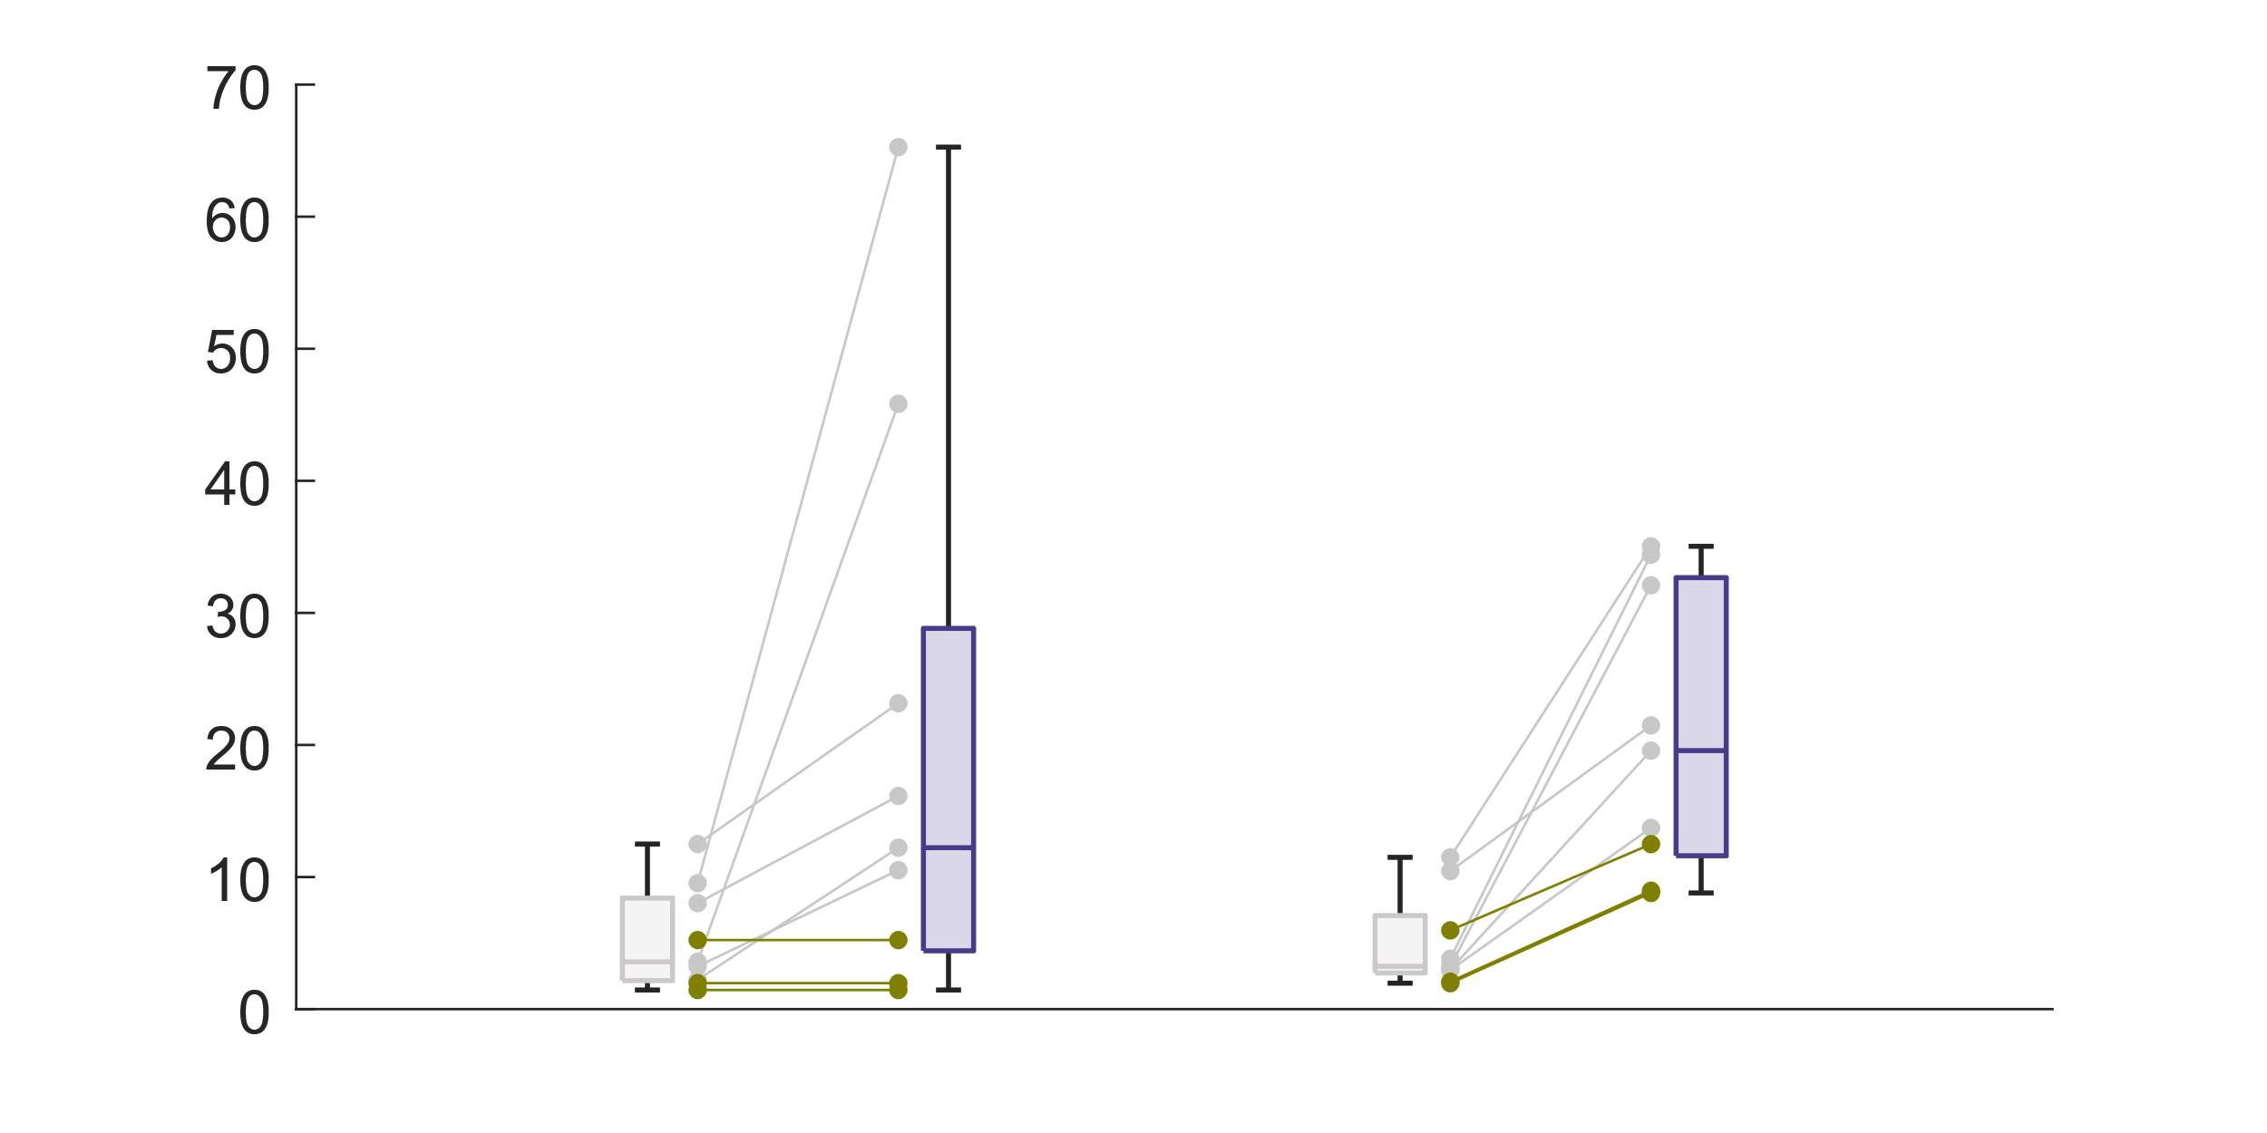
However, estimation of ankle angles was compensated
Normal condition
With OpenSense
Sensor misplacement
Angle (º)
Ankle angles (individual subject)
Other angles (individual subject)
Ground truth
Further look on subject 4
Without OpenSense
Repetition period
Normal condition
Sensor misplacement
RMSE (º)
Without OpenSense
With OpenSense

Slide 19
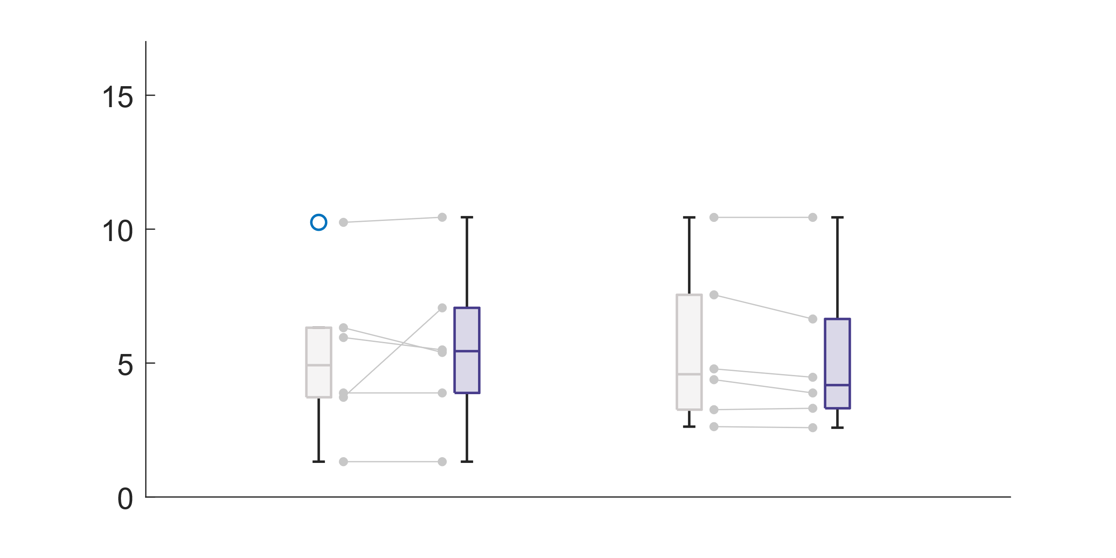
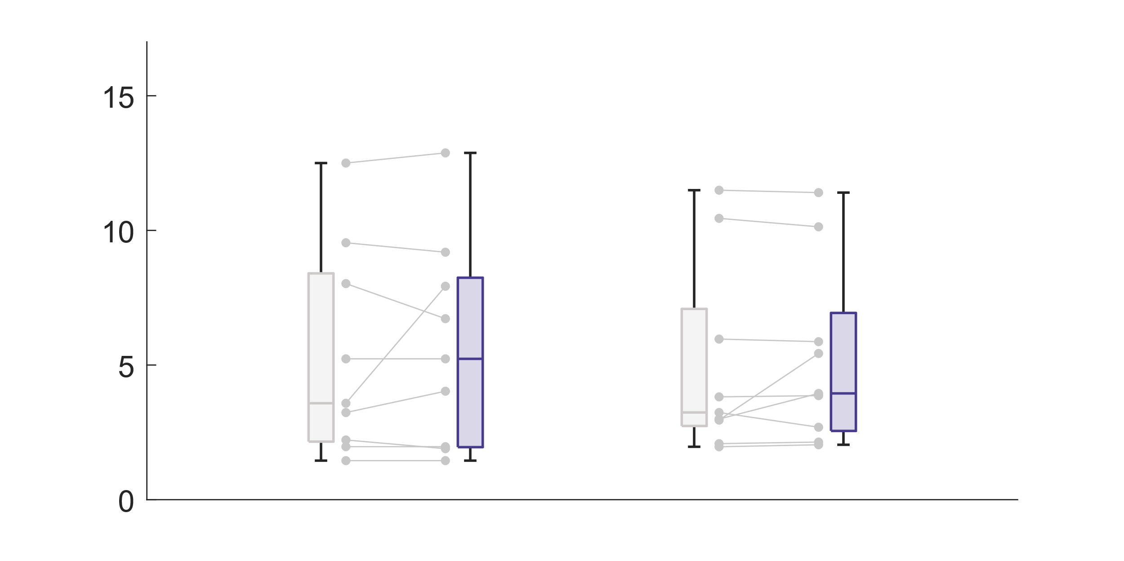
Tight wrapping of sensors could remove the skin/soft tissue motion artifacts
Normal condition
Note: Sensors were wrapped tightly on the body segments.
Sensor misplacement
Angles (individual subject)
Sensor attached on the skin
Sensor attached on the cotton pad
RMSE (º)
Without OpenSense
With OpenSense
Without OpenSense
With OpenSense
*One subject was removed from this analysis due to poor-quality motion capture data

Slide 20
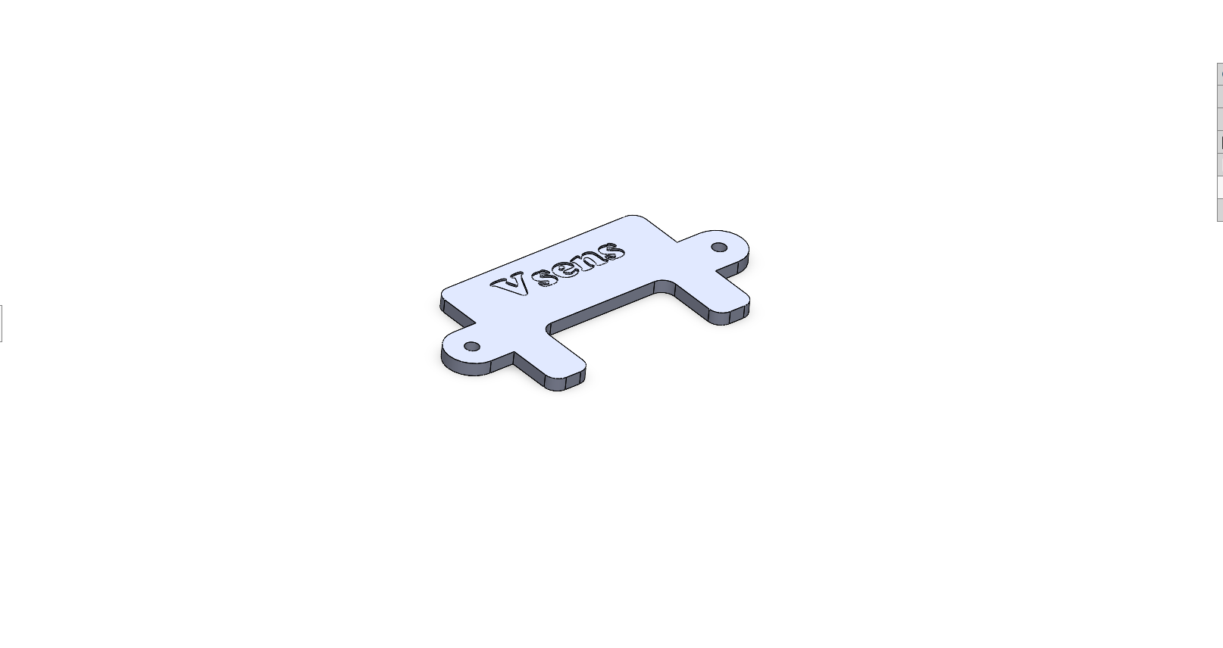
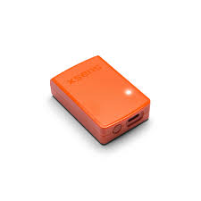
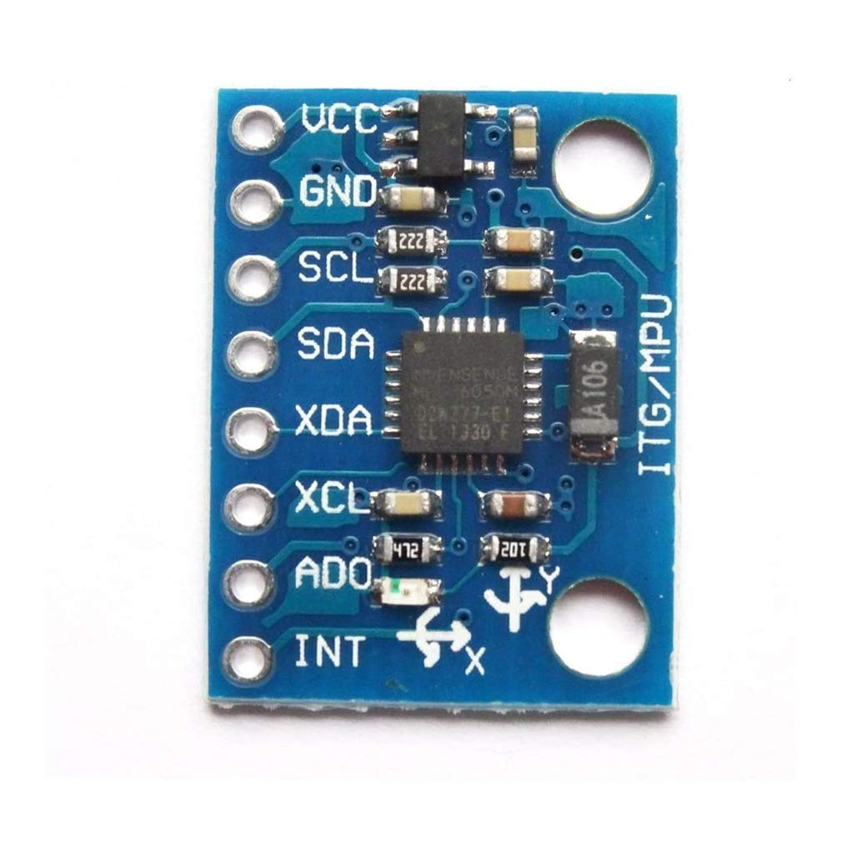
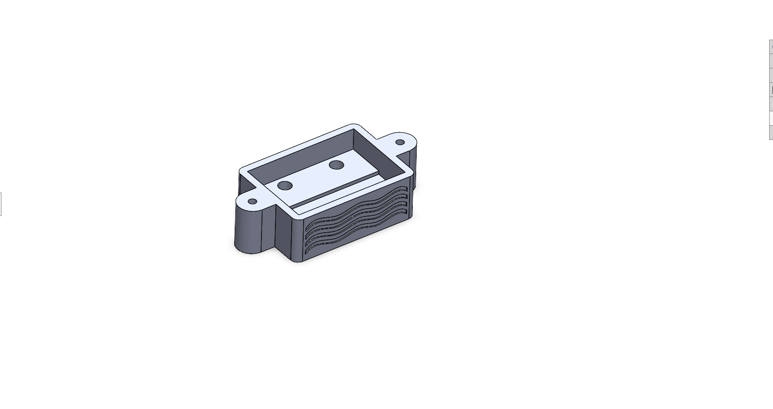
How would these knowledge be valid and translational to real life?
“All theory, dear friend, is grey, but the golden tree of actual life springs ever green”
- Johann Wolfgang von Goethe
6-axis cheap IMU
(< $4, including tax)
9-axis high-end IMU
($200)
Our DIY device
versus

Slide 21
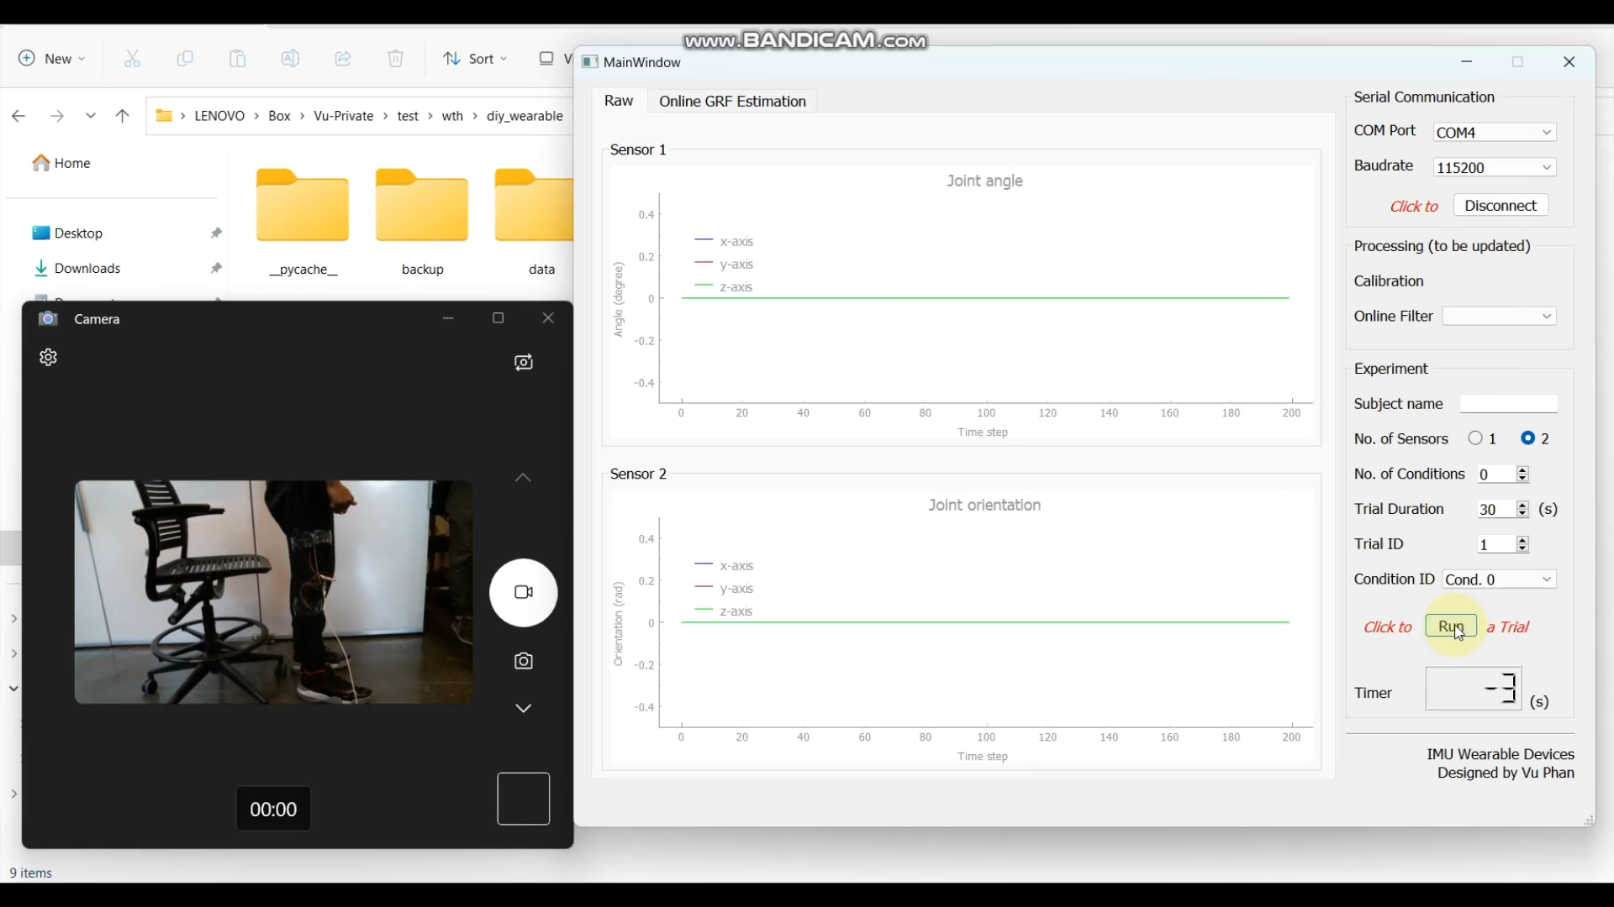
Implementation perspectives
Lack of magnetometer
Low robustness
User experience

Slide 22
Takeaway messages
(Tuning generalizability) The Kalman filter family tuning may be generalizable across various scenarios and tuning may be more generalizable for certain joints, specifically the ankle.
(Filter generalizability) The complimentary filter family may be more generalizable across fields (i.e., no improvement after tuning)
No significant difference between complementary and Kalman filter family given sufficient information (i.e., accelerometer, gyroscope, and magnetometer)
No clear evidence that OpenSense improves the joint kinematics estimation
OpenSense may improve estimation accuracy of a specific joint angle but with some cost on the other angles
Tight wrapping of sensors could remove the skin/soft tissue motion artifacts
Limitations
Limited sample size
Only sit-to-stand task

Slide 23
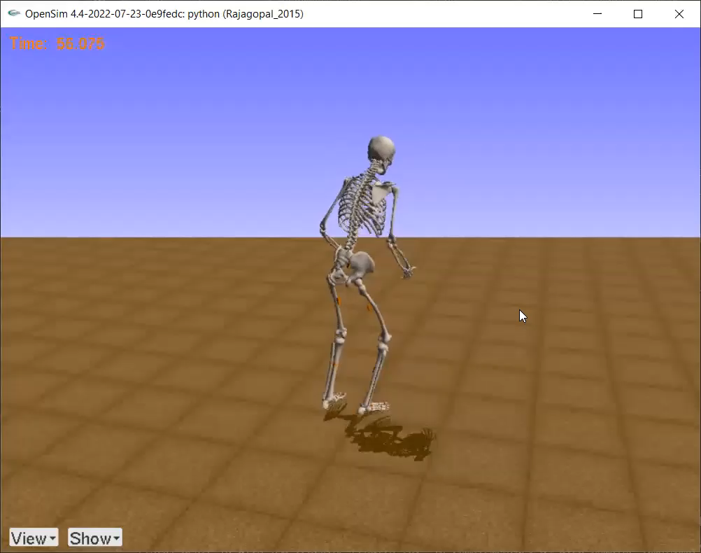
Thank you for your listening!
Q&A?

